Slide 1
Unit II [Primality Testing]

Slide 2
Primality test is a test to determine whether a given number is prime or not.
Novice method
A simple solution is to iterate through all numbers from 2 to n-1 and for every number check if it divides n.
If we find any number that divides, we return false.
Time complexity: O(n) Auxiliary Space: O(1)

Slide 3
O(sqrt(n)) Algorithm for Primality Testing
def isPrime(n):
if n < 2: return False
for i in xrange(2, n):
# from 2 to n-1
if n % i == 0:
# n is divisible by i
return False
return True
from math import sqrt
def isPrime(n):
if n < 2: return False
for i in range(2, int(sqrt(n)) + 1): # from 2 to sqrt(n)
if n % i == 0:
# n is divisible by i
return False
return True

Slide 4
Factorization of a number
Prime factor is the factor of the given number which is a prime number. Factors are the numbers you multiply together to get another number.
In simple words, prime factor is finding which prime numbers multiply together to make the original number.
Example: The prime factors of 15 are 3 and 5
(because 3×5=15, and 3 and 5 are prime numbers).
Practice: WAP for this problem.
https://www.cuemath.com/numbers/prime-factorization/

Slide 5
Finding prime factors by taking the square root [Complete the task]
2 | 24
2 | 12
2 | 6
3 | 3
 | 1
Following are the steps to find all prime factors:
While n is divisible by 2, print 2 and divide n by 2.
After step 1, n must be odd. Now start a loop from i = 3 to square root of n. While i divides n, print i and divide n by i, increment i by 2 and continue.
If n is a prime number and is greater than 2, then n will not become 1 by above two steps.
So print n if it is greater than 2.
Practice: WAP for this problem.
[]
1 | 19
 | 19

Slide 6
Primality Tests
Given an integer n, how can we tell if n is prime? Assume n is odd, since the even case is trivial.
The most obvious idea is to look for factors of n, but no efficient factoring algorithm is known.

Slide 7
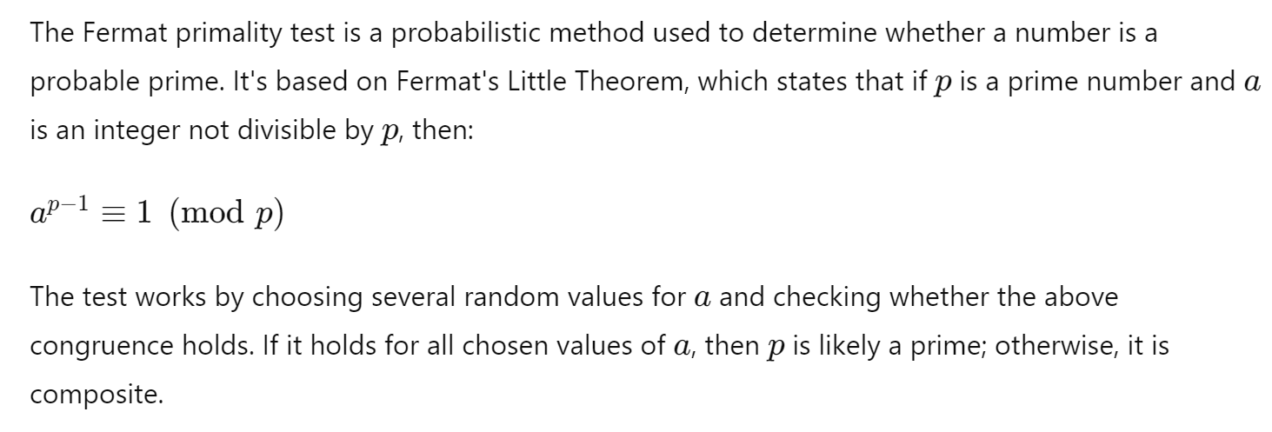
Fermat method [Probabilistic technique]
This method is a probabilistic method.
If a given number is prime, then this method always returns true.
If the given number is composite (or non-prime), then it may return true or false, but the probability of producing incorrect results for composite is low and can be reduced by doing more iterations.
The number p is either a prime or a Carmichael number.

Slide 8
Carmichael numbers are also called Fermat pseudoprimes or absolute Fermat pseudoprimes.
A Carmichael number will pass a Fermat primality test to every base b relatively prime to the number, even though it is not actually prime
This makes tests based on Fermat's Little Theorem less effective than strong probable prime tests such as the Baillie–PSW primality test and the Miller–Rabin primality test.

Slide 9
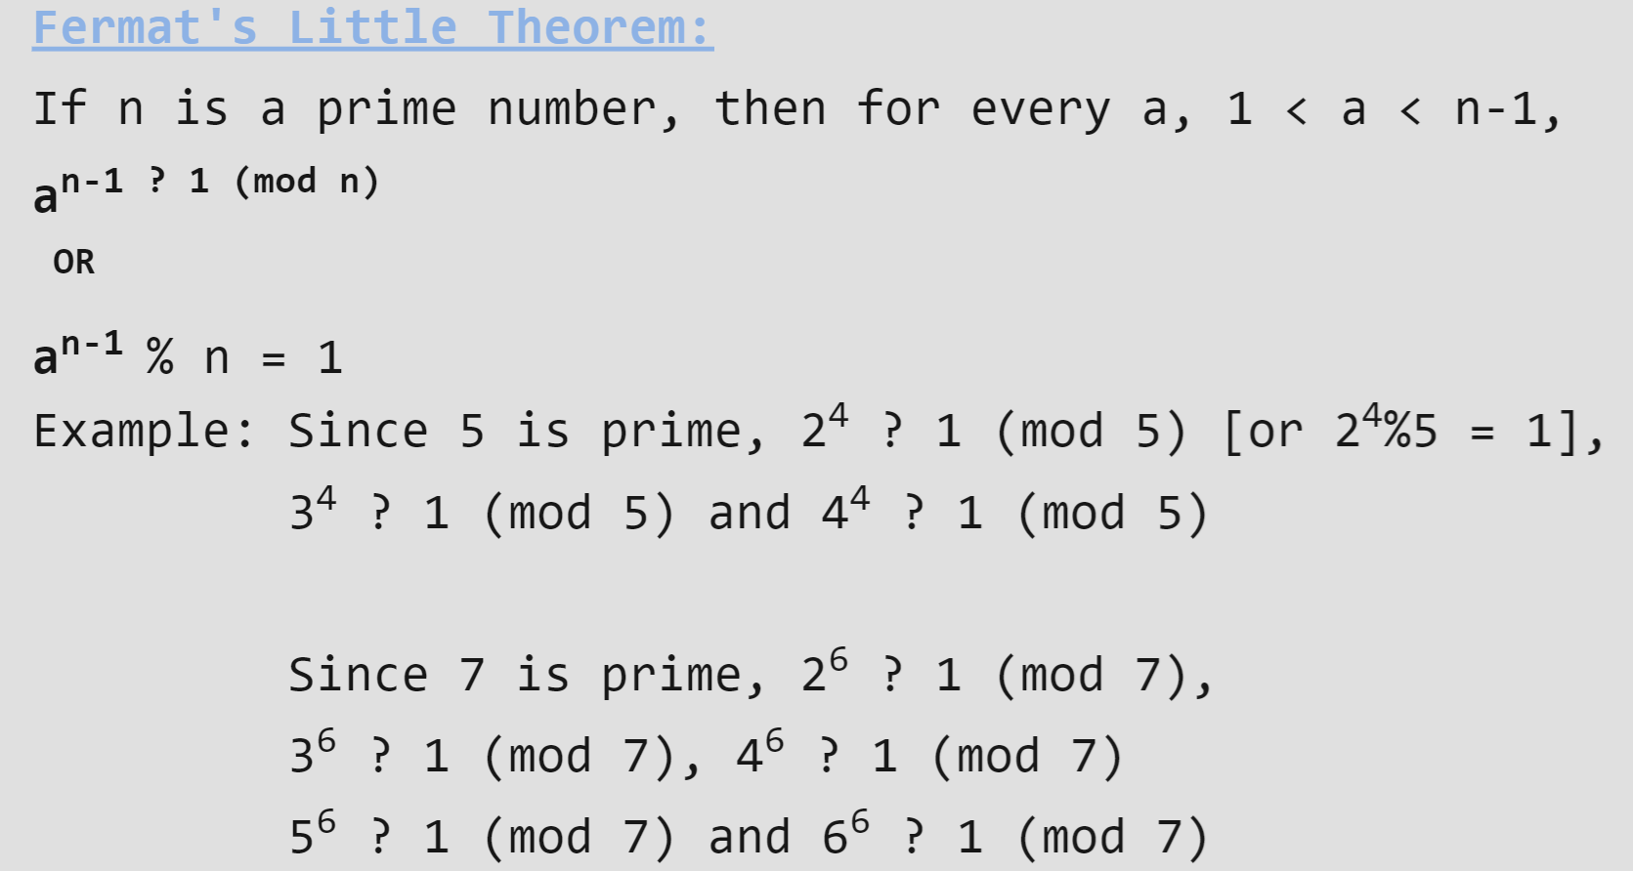

Slide 10
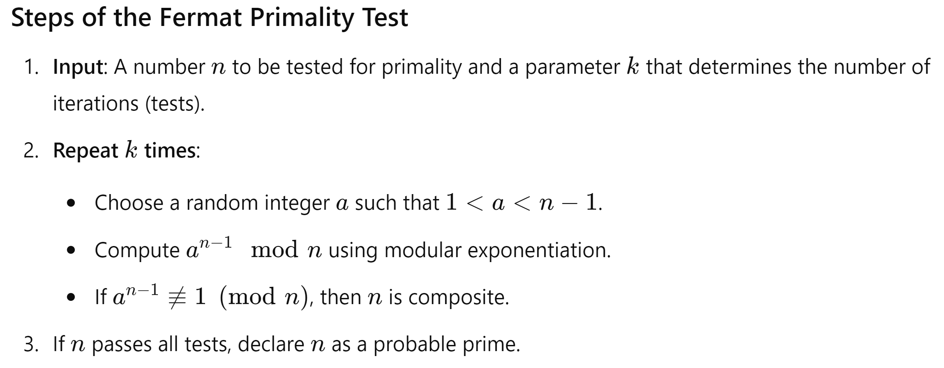

Slide 11
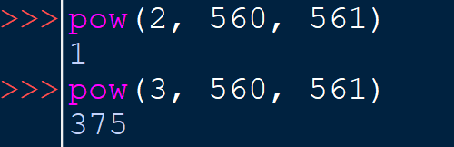
Carmichael number
https://en.wikipedia.org/wiki/Carmichael_number
A Carmichael number is a composite number n that satisfies Fermat's Little Theorem for all integers a that are coprime with n.
This means that for any a such that gcd⁡(a,n)=1 :
a^{n−1}≡1 (mod n)
561 is a Carmichael number. To verify this, we need to check that for any integer a coprime with 561.
a⁵⁶⁰≡1 (mod 561).
561 is the product of three primes:561=3×11×17
The calculation confirms that 3⁵⁶⁰mod=375, which does not equal 1.
The first seven Carmichael numbers, from 561 to 8911: 561,1105,1729,2465,2821,6601,8911

Slide 12
Task
Implement a program to test the number is prime or not using Fermat little theorem method
[Probabilistic technique]

Slide 13
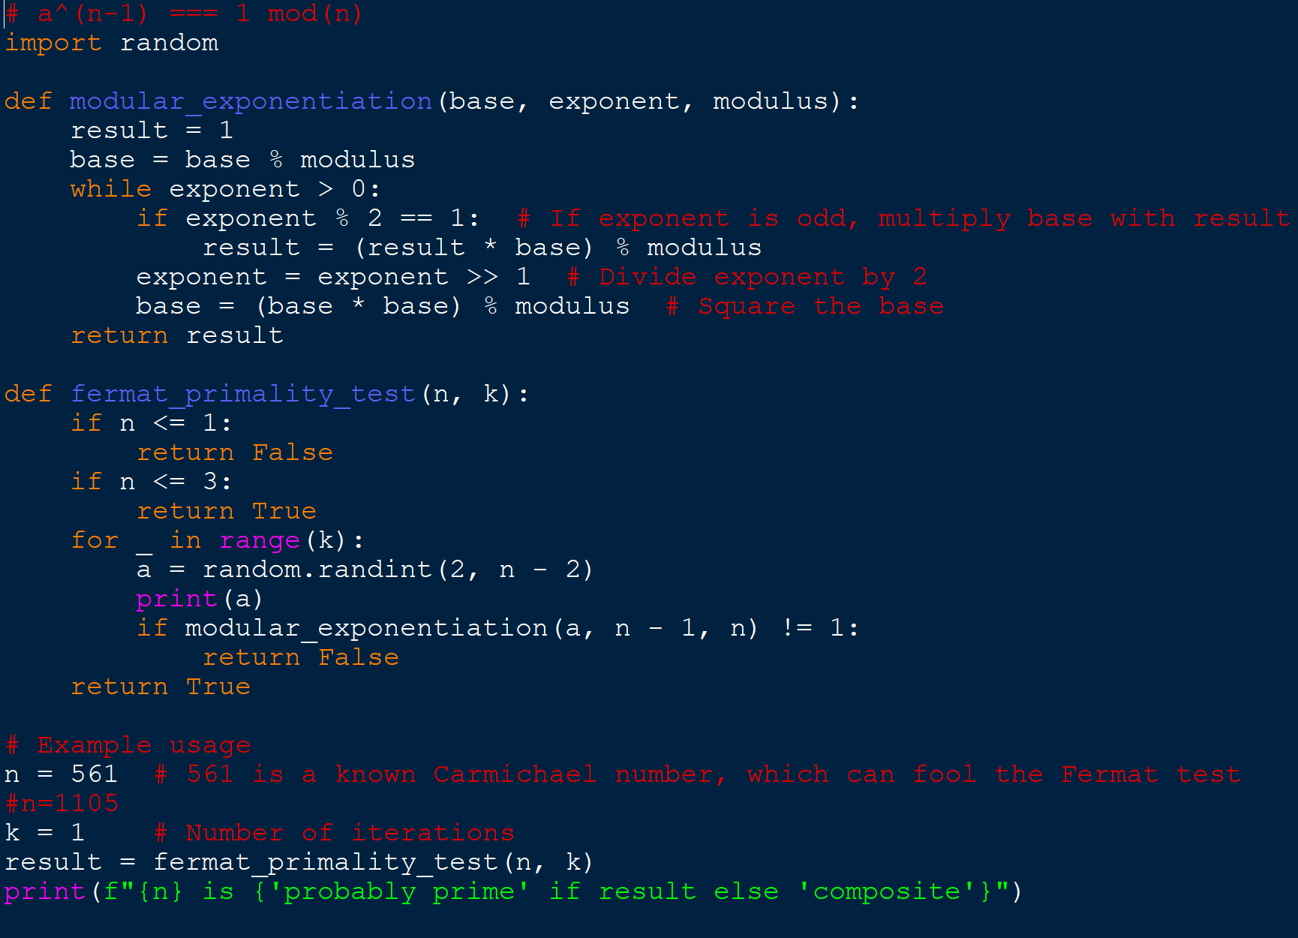

Slide 14
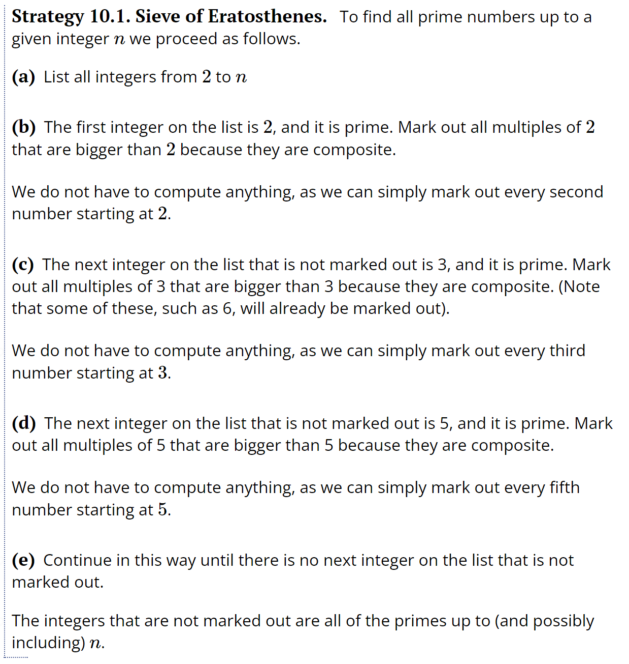
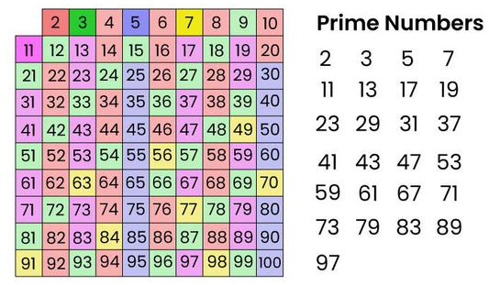
Sieve of Eratosthenes (O(N*log(log(N))))

Slide 15
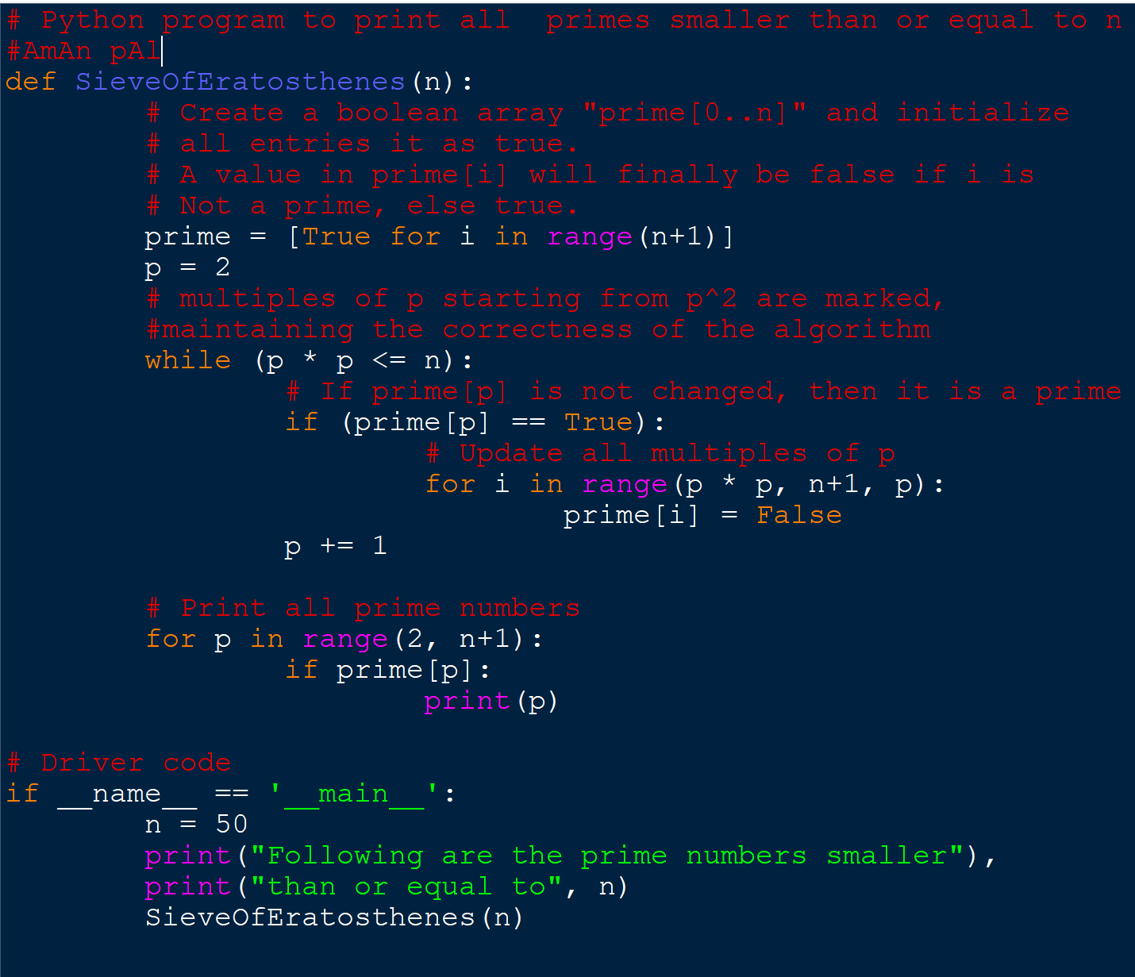
Task
Implement the Sieve of Eratosthenes program

Slide 16
Segmented Sieve Algorithm
The segmented sieve algorithm is an extension of the Sieve of Eratosthenes that is used to find all primes in a given range [low,high].
It is especially useful for large ranges where the basic Sieve of Eratosthenes would require too much memory.
Algo: The segmented sieve algorithm works in two main steps:
Generate all prime numbers up to sqrt (high)​ using the basic Sieve of Eratosthenes.
Use these primes to mark non-prime numbers in the range [low,high].
O(n * ln(sqrt(n)))

Slide 17
Algorithm
https://www.naukri.com/code360/library/segmented-sieve
Initialise a global array, primes[] to store the prime numbers.
Define a method simpleSieve(int x). This method appends all the prime numbers <= x into primes[], x = floor(√N). primes[], now contain all the primes <= √N.
Declare an empty array ANS.
The idea is to partition the interval [0, N - 1] into smaller segments of size ~√N. This is the point at which we optimize space complexity. This ensures that the algorithm runs for a large value of N (up to 109).
For partitioning, we run a loop L : 2 to N - 1, set low = L and high = L + √N - 1. We now have an interval [low, high] of size ~√N. We now call for segmentedSieve(low, high, ANS) which appends all the primes in the range [low, high].
segmentedSieve(low, high, ANS) is defined as:
Initialize a local Boolean array isPrime[] of length high - low + 1 as true.
For all primes P in primes[], we cancel out its multiples in the range [low, high], i.e. we mark them as false. The element at index 0 represents low, and the element at the last index represents high.
Iterate over isPrime[] and append (i + low) if isPrime[i] is true

Slide 18
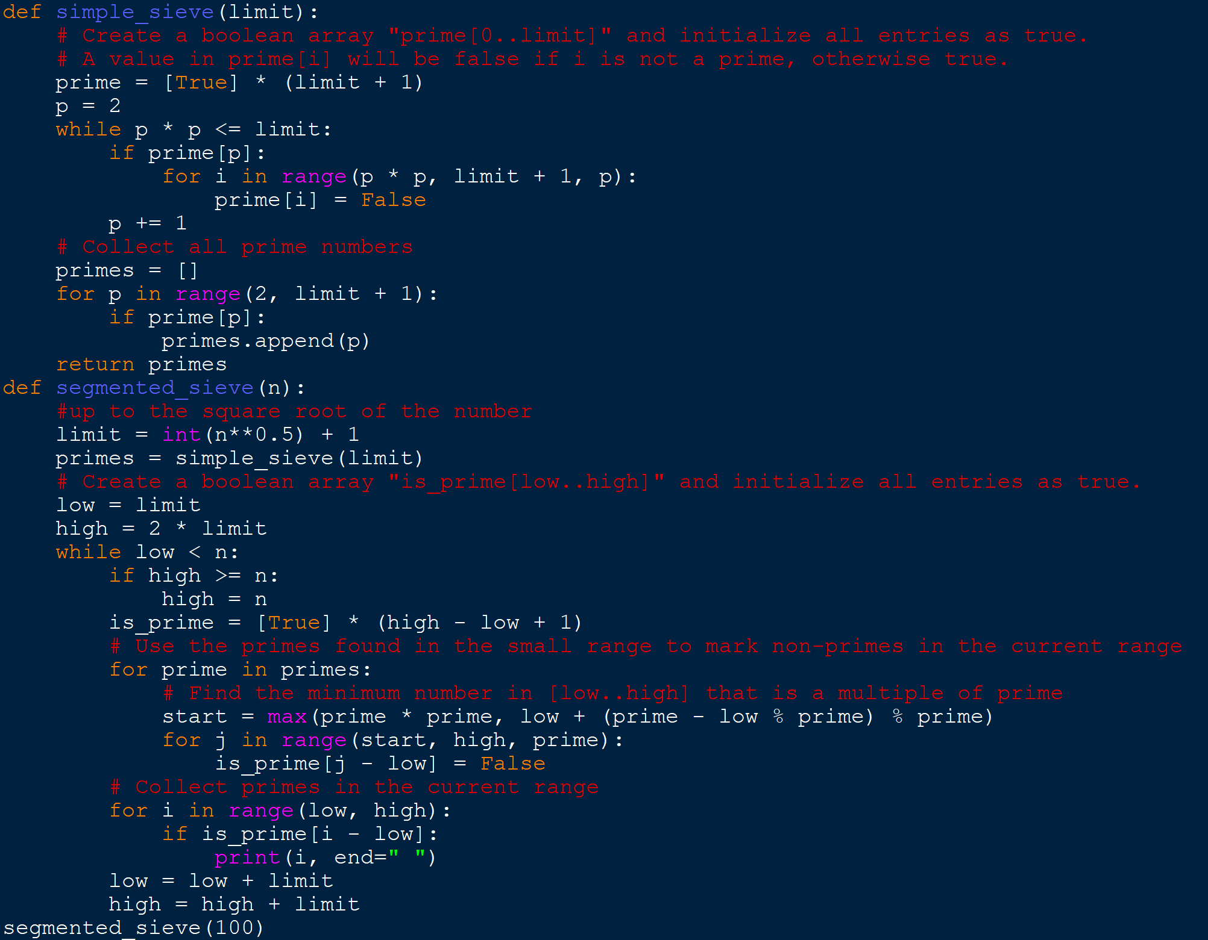
Task
Implement the Segmented Sieve program

Slide 19
Sieve of Atkin
The Sieve of Atkin is a modern algorithm for finding all prime numbers up to a specified integer.
It is faster than the Sieve of Eratosthenes for larger ranges, but it is also more complex.
Case 1: If limit is greater than 2 or 3:
The algorithm treats 2, and 3 as special cases and just adds them to the set of primes to start with.
Case 2: if 4x²+y²=n is odd and modulo-12 remainder is 1 or 5
Since all numbers with modulo-60 remainders 1, 13, 17, 29, 37, 41, 49, or 53 have a modulo-12 remainder of 1 or 5. Therefore, for this filter as well, we have to check if the number is 1 or 5 when taken modulo with 12.
Also, These numbers are prime if and only if the number of solutions to 4x²+y²=n is odd and the number is square-free.
A square-free integer is one that is not divisible by any perfect square other than 1.

Slide 20
Sieve of Atkin …
Case 3: if 3x²+y²=n is odd and modulo-6 remainder is 1
All numbers with modulo-60 remainder 7, 19, 31, or 43 have a modulo-6 remainder of 1.
These numbers are prime if and only if the number of solutions to 3x² + y² = n is odd and the number is square-free.
Case 4: if 3x²-y²=n is odd and modulo-12 remainder is 11
All numbers with modulo-60 remainder 11, 23, 47, or 59 have a modulo-12 remainder of 11.
These numbers are prime if and only if the number of solutions to 3x² – y² = n is odd and the number is square-free.
Case 5: Filtering out all the residual primes which have not yet been found
Due to the filtering of the Sieve of Atkin algorithm, there might be some prime numbers who have been discarded or not found in the above cases.
So to find out those, select all non-primes within limit, and mark all their squares as non-primes.

Slide 21
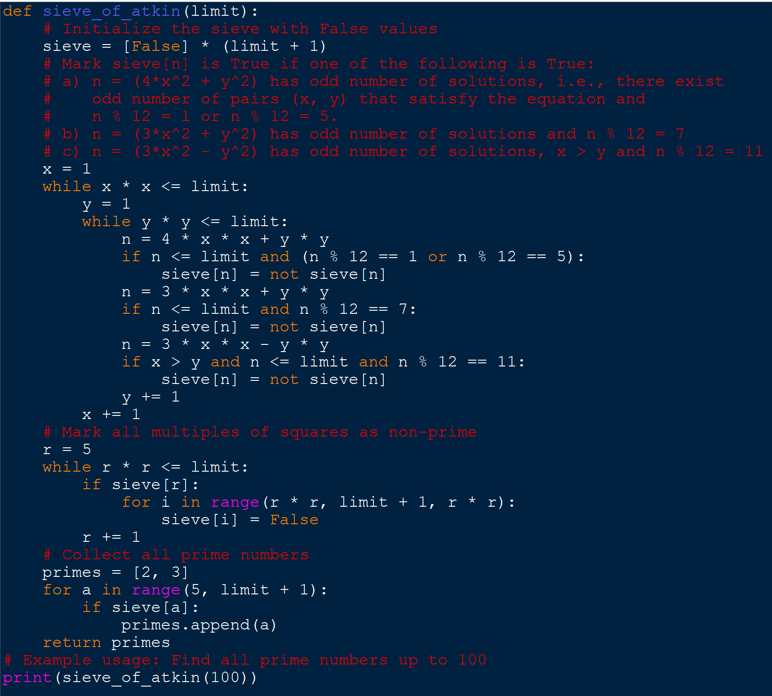
Implement the program of Sieve of Atkin

Slide 22
Task: Solve the problems [Mansi and her series]
Mansi and her series
https://www.geeksforgeeks.org/problems/mansi-and-her-series4249/1
Notes:
N * (Nth prime number ) + N

Slide 23
Collections of Pens
Mr. X went to a stationery shop with an amount of N in his hand.
There are 4 types of pens, each of which cost Rs 1, Rs 2, Rs 5, Rs 10.
Mr. X wants to buy a minimum number of pens, as he has limited space in his pocket but, at the same time he wants to spend all his money.
The task is to find the minimum number of pens geek will buy.
https://www.geeksforgeeks.org/problems/geek-and-pens/0

Slide 24
Next prime palindrome
You will be given a positive integer N.
Your task is to find the smallest number
greater than or equal to N
that is a prime and a palindrome.
https://www.geeksforgeeks.org/problems/next-prime-palindrome4153/1

Slide 25
Unit III [Recursion and Advanced Techniques]

Slide 26
Introduction to recursion
Recursion means "defining a problem in terms of itself". This can be a very powerful tool in writing algorithms. Recursion comes directly from Mathematics, where there are many examples of expressions written in terms of themselves. For example, the Fibonacci sequence is defined as: F(i) = F(i-1) + F(i-2)
Recursion is an amazing technique with the help of which we can reduce the length of our code and make it easier to read and write.
https://users.cs.utah.edu/~germain/PPS/Topics/recursion.html#:~:text=Recursion%20means%20%22defining%20a%20problem,%2B%20F(i%2D2)

Slide 27
A Mathematical Interpretation
approach(1) – Simply adding one by one
f(n) = 1 + 2 + 3 +……..+ n
approach(2) – Recursive adding
f(n) = 1 n=1
f(n) = n + f(n-1) n>1
Base condition

Slide 28
Why Recursion Works
In a recursive algorithm, the computer "remembers" every previous state of the problem. This information is "held" by the computer on the "activation stack" (i.e., inside of each functions workspace).
Every function has its own workspace PER CALL of the function.

Slide 29
How memory is allocated to different function calls in recursion?
When any function is called from main(), the memory is allocated to it on the stack.
A recursive function calls itself, the memory for a called function is allocated on top of memory allocated to the calling function and a different copy of local variables is created for each function call.
When the base case is reached, the function returns its value to the function by whom it is called and memory is de-allocated and the process continues.

Slide 30
Recursion VS Iteration
SR No. | Recursion | Iteration
1) | Terminates when the base case becomes true. | Terminates when the condition becomes false.
2) | Used with functions. | Used with loops.
3) | Every recursive call needs extra space in the stack memory. | Every iteration does not require any extra space.
4) | Smaller code size. | Larger code size.

Slide 31
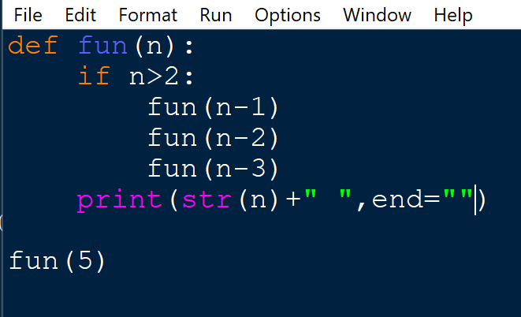
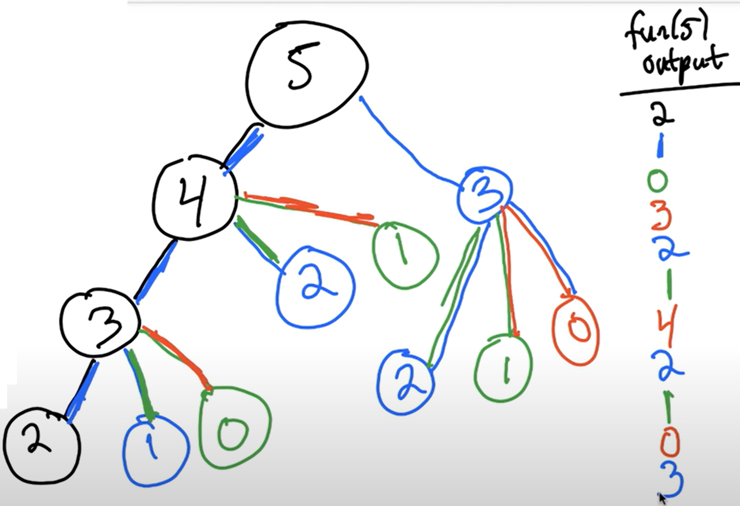
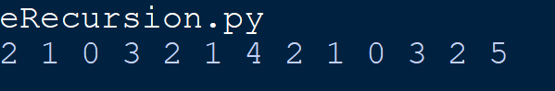
Multiple Recursion
Complixity : O (3^n)

Slide 32
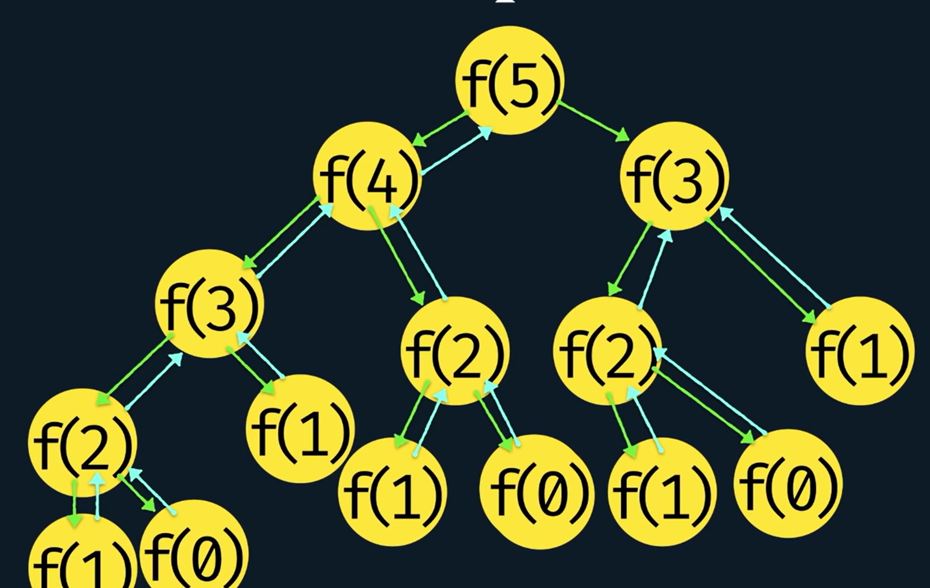

Slide 33
Solving problems using recursion [Task]
Factorial
Fibonacci
Reversing a string

Slide 34
Memoization:[Modern Approaches]
Concept: Storing the results of expensive function calls and reusing them when the same inputs occur again.
memo = {}
def m_fib(n):
if n in memo:
return memo[n]
if n <= 1:
return n
memo[n] = m_fib(n - 1) + m_fib(n - 2)
return memo[n]
Classic Approaches to Recursion
def fibonacci(n):
if n <= 1:
return n
else:
return fibonacci(n - 1) + fibonacci(n - 2)

Slide 35
Direct vs. Indirect Recursion
Direct recursion: This is typified by the factorial implementation where the methods call itself.
In-Direct recursion: This happens where one method, say method A, calls another method B, which then calls method A. This involves two or more methods that eventually create a circular call sequence.
Head recursion: The recursive call is made at the beginning of the method.
Tail recursion: The recursive call is the last statement.

Slide 36
Indirect Recursion
# Define the limit
N = 10
# Initialize the starting number
n = 1
# Function to print odd numbers and call the even function
def print_odd():
global n
if n <= N:
print(n, end=" ")
n += 1
print_even()
# Function to print even numbers and call the odd function
def print_even():
global n
if n <= N:
print(n, end=" ")
n += 1
print_odd()
# Start the recursion with the odd function
print_odd()

Slide 37
Tailed vs. Non-Tailed Recursion
Tail recursion is defined by having the recursive call as the last operation in the function before returning
While non-tail recursion involves other operations after the recursive call
def fact_n_tail_rec(n):
if n == 0 or n == 1:
return 1
else:
return n * fact_n_tail_rec(n - 1)
# Example usage
print(factorial_non_tail_recursive(5)) # Output: 120
function factorial (cuNum , previousMultiplication):
if cuNum is less or equal to 0 then
return previousMultiplication
else
return factorial( cuNum – 1, cuNum * previousMultiplication )
// Tail Recursion
end
end

Slide 38
Feature | Tail Recursion | Non-Tail Recursion
Definition | A recursive function is said to be tail-recursive if the recursive call is the last thing done in the function before returning. | A recursive function is said to be non-tail-recursive if the recursive call is not the last thing done in the function before returning.
Base Case Handling | Usually, the base case is handled at the end of the function after the recursive call. | Usually, the base case is handled before making the recursive call.
Stack Usage | Typically, tail recursion can be optimized by compilers/interpreters to use a constant amount of stack space. | Typically, non-tail recursion uses more stack space because each recursive call creates a new frame on the call stack.
Optimization Potential | Can be optimized for tail call elimination, improving stack space efficiency. | May not be optimized for tail call elimination, which can lead to stack overflow errors.
Examples | Factorial function, some tree traversals, mutual recursions with multiple recursive calls. | Fibonacci sequence, recursive algorithms without the tail call optimization.

Slide 39
Trail vs Non trail
Tail recursion is defined by having the recursive call as the last operation in the function before returning
function factorial (currentNumber , previousMultiplication):
if currentNumber is less or equal to 0 then
return previousMultiplication
else
return factorial( currentNumber – 1, currentNumber * previousMultiplication )
// Tail Recursion
end
End
Non-tail recursion involves other operations after the recursive call
function factorial ( n ):
if n is less or equal to 0 then
return 1
else
return n * factorial ( n – 1 )
// Non-Tail Recursion
end
end

Slide 40
Non-Tailed Recursion
In a non-tail-recursive factorial function, the recursive call is not the last operation. This means that each recursive call must wait for the result of the next recursive call before it can return.
def factorial_non_tail_recursive(n):
if n == 0 or n == 1:
return 1
else:
return n * factorial_non_tail_recursive(n - 1)
# Example usage
print(factorial_non_tail_recursive(5)) # Output: 120

Slide 41
Tailed Recursion
In a tail-recursive factorial function, the recursive call is the last operation. Python does not optimize tail recursion, but it demonstrates the concept.
def factorial_tail_recursive(n, accumulator=1):
if n == 0 or n == 1:
return accumulator
else:
return factorial_tail_recursive(n - 1, n * accumulator)
# Example usage
print(factorial_tail_recursive(5)) # Output: 120

Slide 42
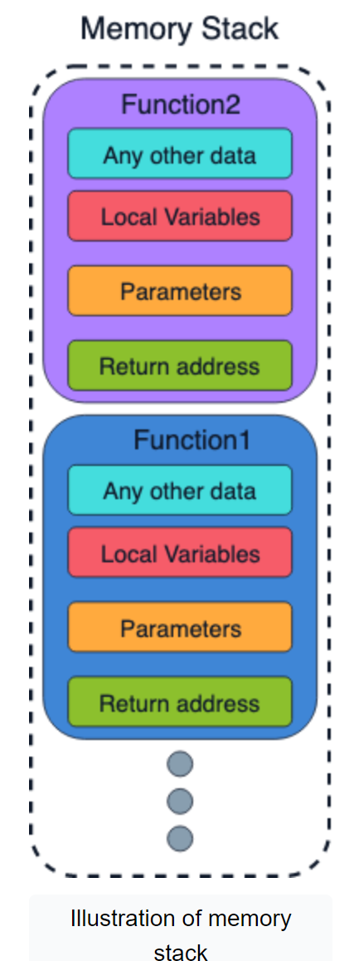
Memory Allocation in Recursion
A recursive function is no different from any other function--automatic local variables are allocated as a single block by advancing the stack pointer far enough to account for the sum of their sizes (plus any padding required for alignment).
Each recursive call pushes a new stack frame in that manner, then pops it when it returns. If the recursion fails to reach a base case, the stack will rapidly be exhausted leading to the eponymous Stack Overflow crash.

Slide 43
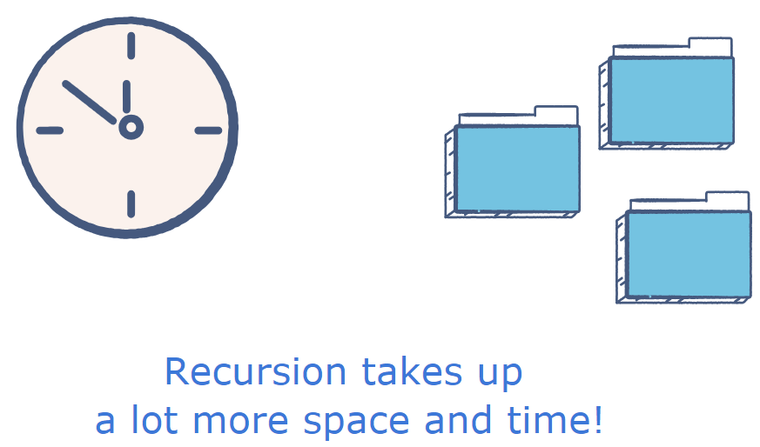
Disadvantages of recursive programming
Recursion, broadly speaking, has the following disadvantages:
A recursive program has greater space requirements than an iterative program as each function call will remain in the stack until the base case is reached.
It also has greater time requirements because each time the function is called, the stack grows and the final answer is returned when the stack is popped completely.

Slide 44
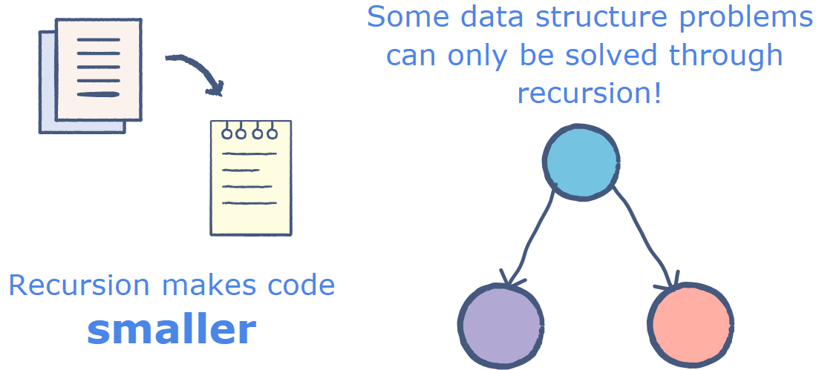
Advantages of recursive programming
Recursion has the following advantages:
For a recursive function, you only need to define the base case and recursive case, so the code is simpler and shorter than an iterative code.
Some problems are inherently recursive, such as Graph and Tree Traversal.

Slide 45
Disadvantages of Recursion
Memory usage. – Recursion can be memory-intensive, as each recursive function call creates a new stack frame. This can lead to memory usage issues, especially in programs that use recursion extensively or on large datasets.
Stack overflow. – Recursion can lead to stack overflow errors, which occur when the call stack exceeds its allocated size. This can happen when a recursive function calls itself too many times, or when the recursion depth is too deep.
Difficulty in understanding and debugging. – Recursion can be difficult to understand and debug, especially in complex programs. Recursive functions may have multiple exit conditions, and it can be challenging to determine which one is being triggered at any given time.
Slower execution time. – Recursion can be slower than iterative solutions, as each function call incurs overhead costs such as parameter passing and stack manipulation. This can lead to slower execution times in programs that use recursion frequently.
Limited applicability. – Recursion may not be applicable or efficient for all programming problems. Some problems may have more efficient iterative solutions, and others may not lend themselves well to recursive solutions at all.

Slide 46
Advantages of Recursion
Simplifies complex problems. – Recursion can simplify complex problems by breaking them down into smaller, more manageable sub-problems. This can make it easier for programmers to understand and solve the problem at hand.
Saves time and space. – Recursion can save time and space by reducing the amount of code needed to solve a problem. This is because recursive functions can be more concise and elegant than non-recursive functions.
Increases code readability. – Recursion can increase code readability by making the code easier to understand and follow. Recursive functions often have a clear and logical structure that can make it easier for other programmers to understand and modify the code.
Enables efficient data processing. – Recursion can enable efficient data processing by allowing for more efficient data storage and retrieval. Recursive functions can be used to traverse data structures like trees and graphs, which can be difficult or impossible to do using non-recursive functions.
Facilitates problem solving. – Recursion can facilitate problem solving by providing a flexible and powerful tool for programmers to use. Recursive functions can be used in a wide variety of contexts, from simple mathematical calculations to complex artificial intelligence algorithms.

Slide 47
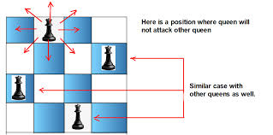
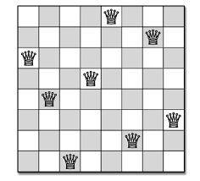
Backtracking [Todo: follow the link and implement the solution of the problem]
https://www.hackerearth.com/practice/basic-programming/recursion/recursion-and-backtracking/tutorial/
N-Queens Problem: Given a chess board having N×N cells, we need to place N queens in such a way that no queen is attacked by any other queen. (A queen can attack horizontally, vertically and diagonally.)

Slide 48
Recamans sequence
https://www.geeksforgeeks.org/problems/recamans-sequence4856/1?itm_source=geeksforgeeks&itm_medium=article&itm_campaign=practice_card

Slide 49
Backtracking vs Recursion
The process in which a function calls itself directly or indirectly is called recursion and the corresponding function is called a recursive function.
Backtracking is an algorithmic technique for solving problems recursively by trying to build a solution incrementally, one piece at a time, removing those solutions that fail to satisfy the constraints of the problem at any point in time (by time, here, is referred to the time elapsed till reaching any level of the search tree).

Slide 50
Sl. No. | Recursion | Backtracking
1 | A recursive function solves a particular problem by calling a copy of itself and solving smaller subproblems of the original problems. | Backtracking at every step eliminates those choices that cannot give us the solution and proceeds to those choices that have the potential of taking us to the solution.
2 | Recursion is a part of backtracking itself and it is simpler to write. | Backtracking is comparatively complex to implement.
3 | Applications of recursion are Tree and Graph Traversal, Towers of Hanoi, Divide and Conquer Algorithms, Merge Sort, Quick Sort, and Binary Search. | Application of Backtracking is N Queen problem, Rat in a Maze problem, Knight’s Tour Problem, Sudoku solver, and Graph coloring problems.
https://www.geeksforgeeks.org/what-is-the-difference-between-backtracking-and-recursion/?ref=roadmap

Slide 51
Problem related to backtracking
https://www.geeksforgeeks.org/print-the-dfs-traversal-step-wise-backtracking-also/
https://www.geeksforgeeks.org/rat-in-a-maze-backtracking-using-stack/

Slide 52
Memoization
Memoization is a specific form of caching that is used in dynamic programming.
The purpose of caching is to improve the performance of our programs and keep data accessible that can be used later.
It basically stores the previously calculated result of the subproblem and uses the stored result for the same subproblem.
This removes the extra effort to calculate again and again for the same problem.
And we already know that if the same problem occurs again and again, then that problem is recursive in nature.
Example
https://www.geeksforgeeks.org/what-is-memoization-a-complete-tutorial/

Slide 53
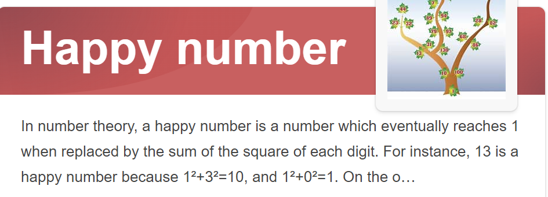
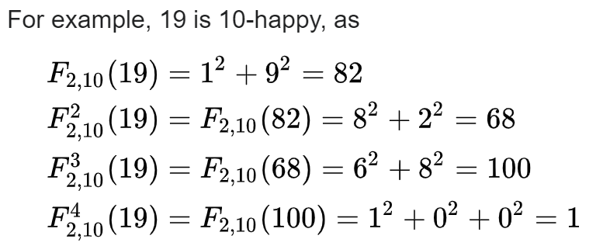
Recursive problems- next happy number
2, 3, 4, 5, 6, 8, 9, 11, 12, 14, 15, 16, 17, 18, 20: These are some of the first unhappy numbers
Solve this problem: https://www.geeksforgeeks.org/problems/next-happy-number4538/1

Slide 54
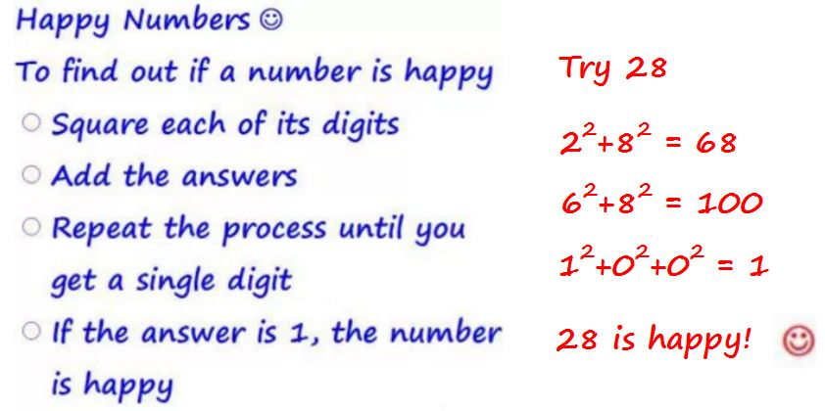
https://images.app.goo.gl/koGknubfNasCDern8

Slide 55
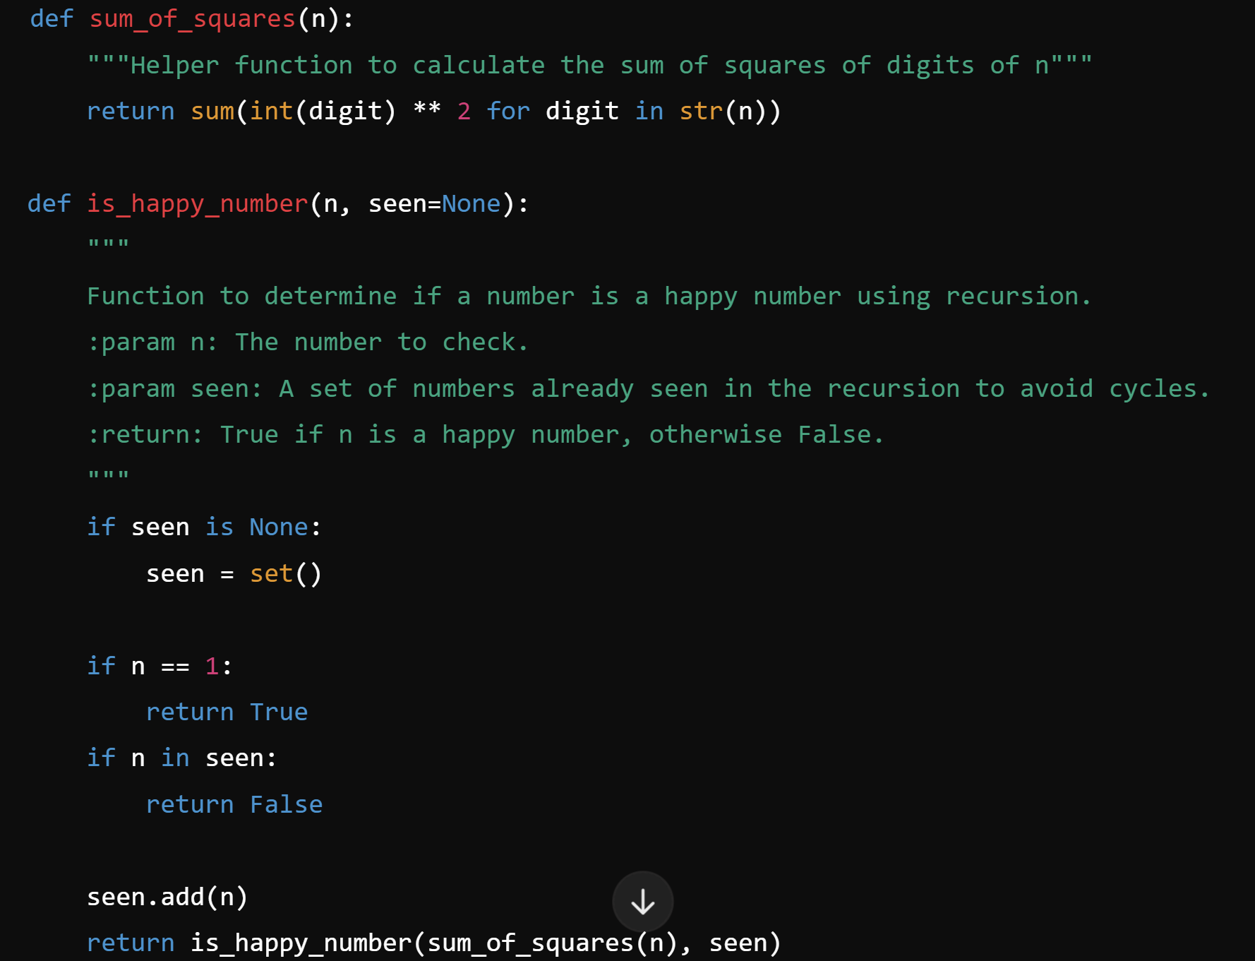
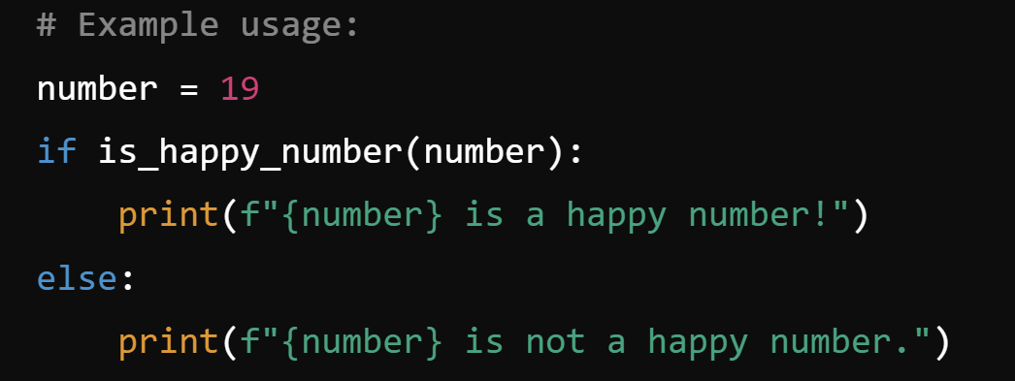

Slide 56
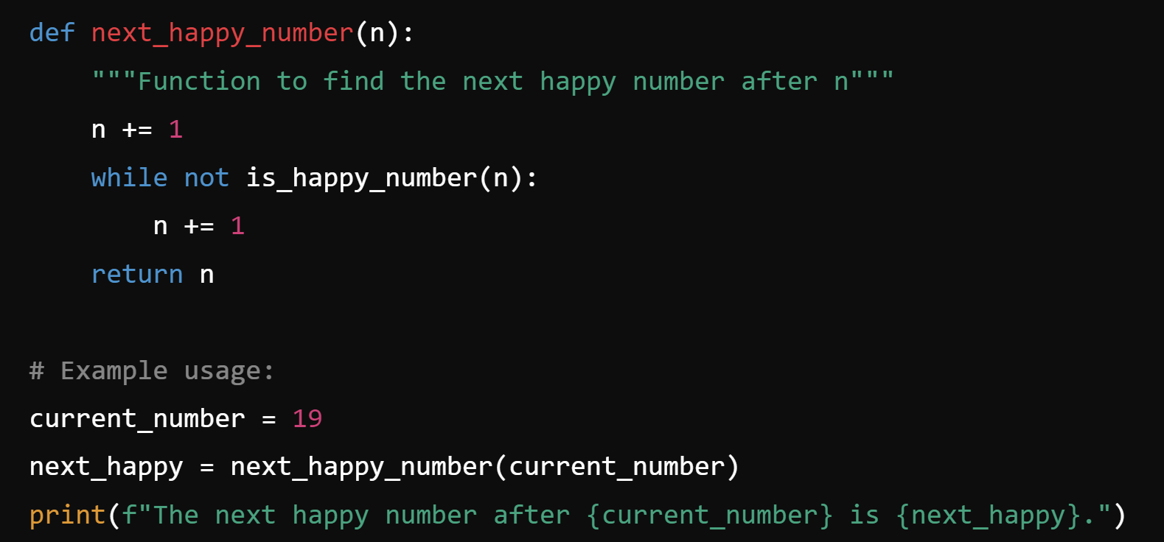
Next happy number
Generates the next happy number after a given number. [Use above logic]

Slide 57
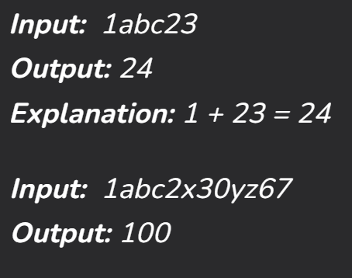
Sum string
Given a string S containing alphanumeric characters, The task is to calculate the sum of all numbers present in the string.
Reference: https://www.geeksforgeeks.org/calculate-sum-of-all-numbers-present-in-a-string/
Scan each character of the input string;
if a number is formed by consecutive characters of the string: then increment the result by that amount
//The only tricky part of this question is that
//multiple consecutive digits are considered one number.

Slide 58
Follow the below steps to implement the idea:
Create an empty string temp and an integer sum.
Iterate over all characters of the string.
If the character is a numeric digit add it to temp.
Else convert temp string to number and add it to sum, empty temp.
Return sum + number obtained from temp.

Slide 59
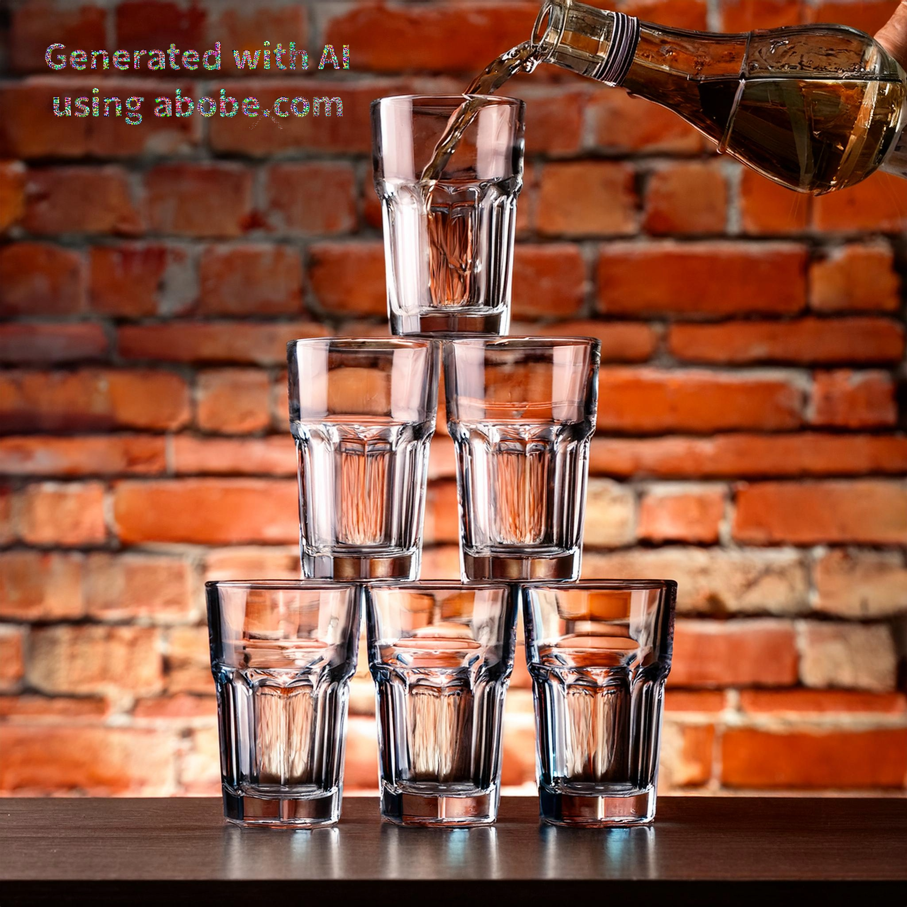
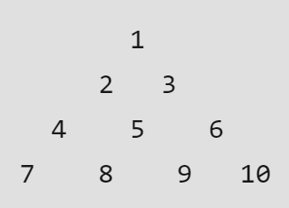
Water overflow

Slide 60
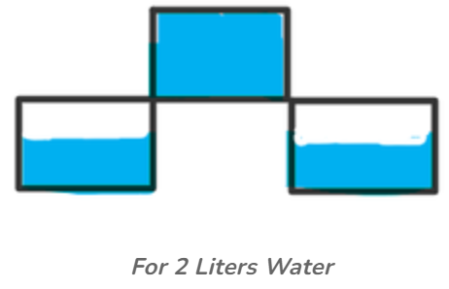
Water overflow
There are some glasses with equal capacity as 1 litre. The glasses are kept as follows:
You can put water to the only top glass. If you put more than 1-litre water to 1st glass, water overflows and fills equally in both 2nd and 3rd glasses. Glass 5 will get water from both 2nd glass and 3rd glass and so on.
If you have X litre of water and you put that water in a top glass, how much water will be contained by the j^{th} glass in an i^{th} row?
Example. If you will put 2 litres on top.
1st – 1 litre , 2nd – 1/2 litre , 3rd – 1/2 litre

Slide 61
Problem: https://www.geeksforgeeks.org/problems/champagne-overflow2636/1
Reference: https://www.geeksforgeeks.org/find-water-in-a-glass/
[Pascal triangle] https://www.geeksforgeeks.org/pascal-triangle/

Slide 62
Unit IV [Basic Dynamic Programming]

Slide 63
4.1 Introduction to Dynamic Programming (DP)
Dynamic Programming (DP) is a method for solving complex problems by breaking them down into simpler subproblems.
DP is particularly useful for optimization problems, where the goal is to find the best solution among many possibilities.
The key idea behind DP is to solve each subproblem only once and store its result, so that it doesn't need to be recalculated when needed again.
This is achieved by employing techniques such as memoization or tabulation.

Slide 64
Example
: Fib(n) = Fib(n-1) + Fib(n-2)
For n = 5, the naive recursive approach
would compute many values repeatedly,
leading to an exponential time complexity.
With DP,
we store the results of Fib(1), Fib(2), and so on,
which allows us to compute Fib(n) efficiently.
The Fibonacci pattern can be observed in nature, and it is often considered a fundamental problem of dynamic programming.

Slide 65
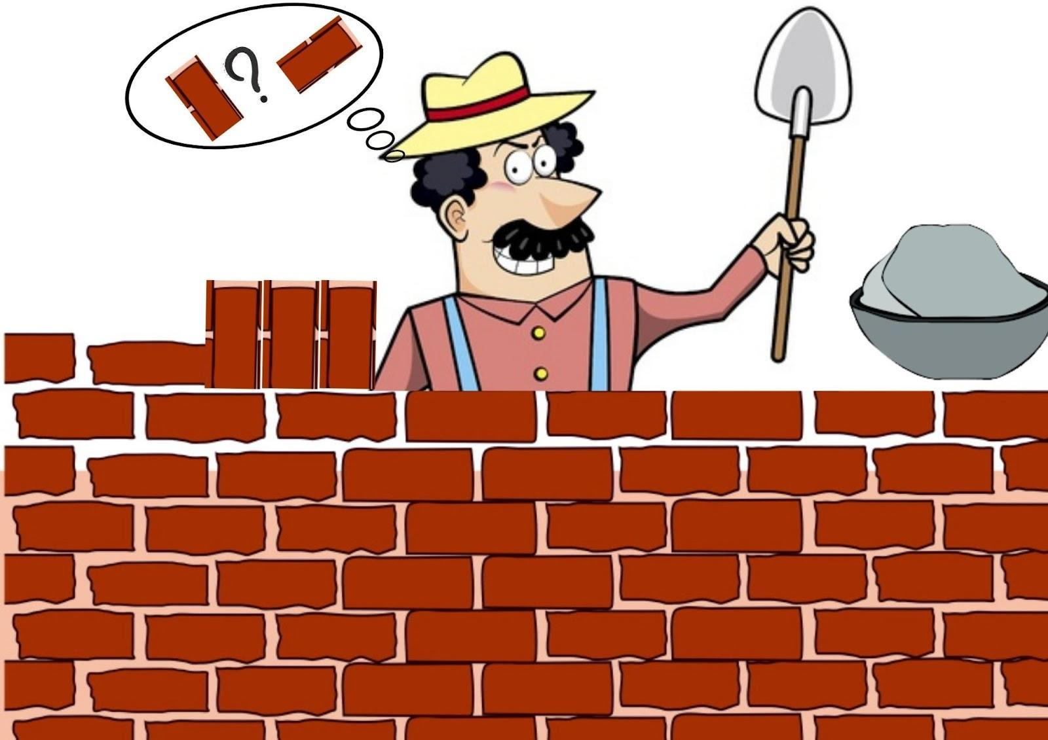
4.2 Tiling Problem
Consider a board of size 2 * N and tiles of size “2 * 1”.
You have to count the number of ways in which tiling of this board is possible.
You may place the tile vertically or horizontally, as per your choice.
Time Complexity: O(2^n)

Slide 66
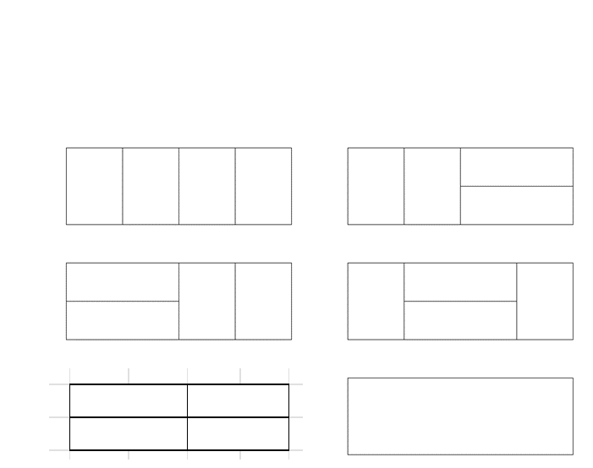
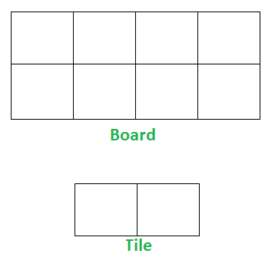
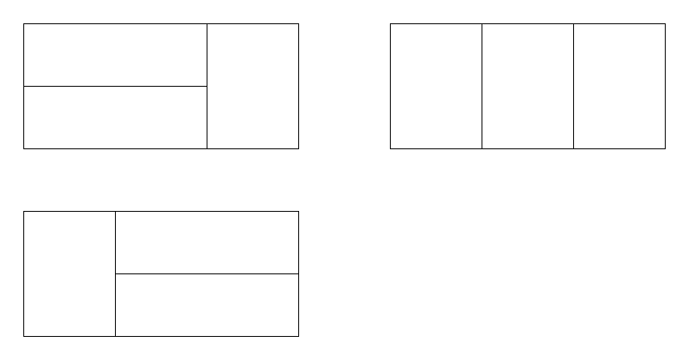
If N= 3 => board 2*3 Explanation:
We need 3 tiles to tile the board of size 2 x 3.
Place all 3 tiles vertically.
Place 1 tile vertically and remaining 2 tiles horizontally (2 ways)
Output: 3
If N = 4 => 2 x 4 board Explanation:
All 4 vertical (1 way)
All 4 horizontal (1 way)
2 vertical and 2 horizontal (3 ways)
Output: 5

Slide 67
Practice problem:
https://www.geeksforgeeks.org/problems/ways-to-tile-a-floor5836/1
Reading material:
https://www.geeksforgeeks.org/tiling-problem/
https://www.geeksforgeeks.org/domino-and-tromino-tiling-problem/?ref=asr1

Slide 68
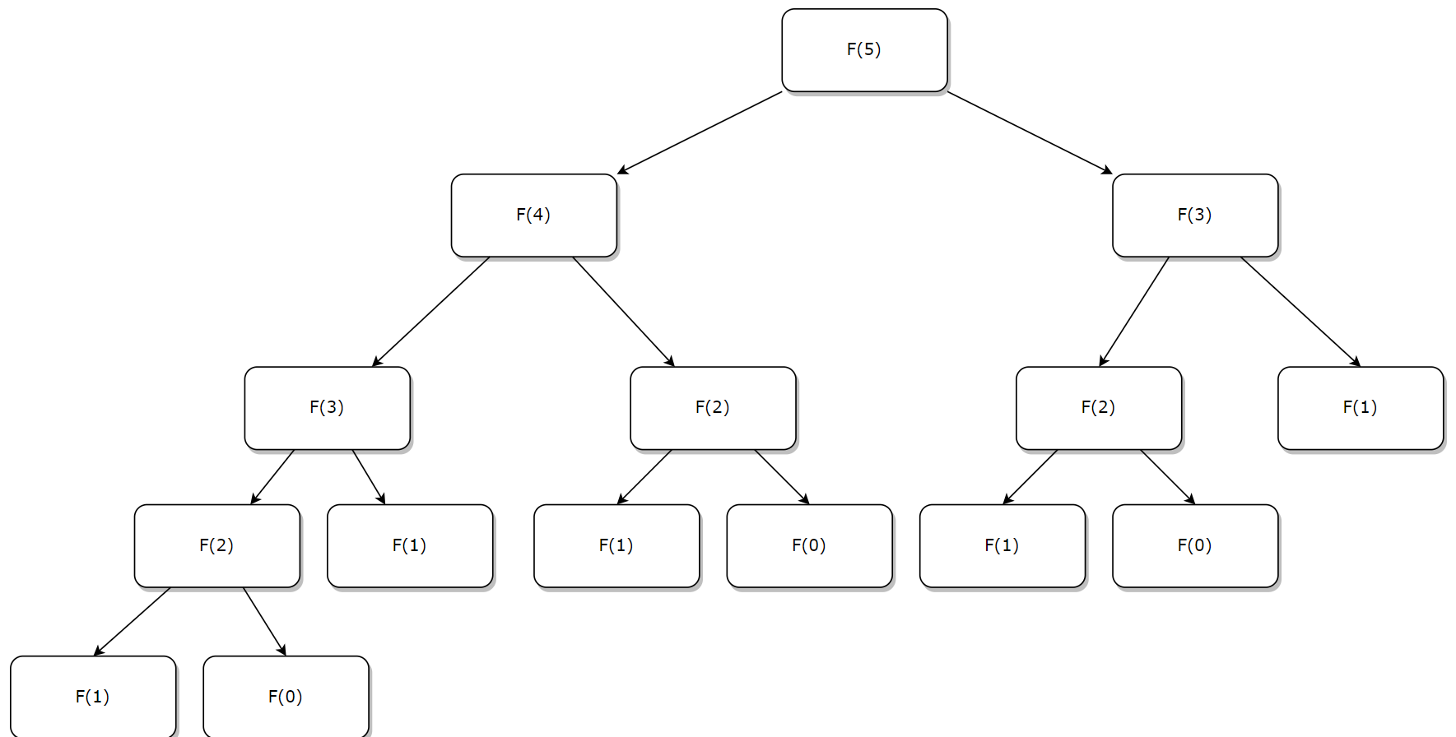
4.3 Problem with Recursive Approach

Slide 69
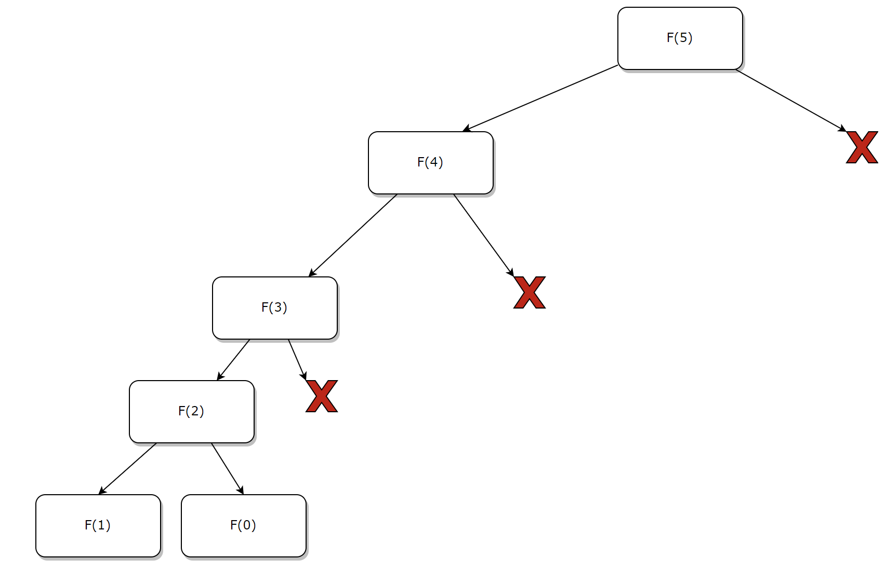
4.3.1 The Top-Down Approach memoization
The first dynamic programming approach we’ll use is the top-down approach.
The idea here is similar to the recursive approach, but the difference is that we’ll save the solutions to subproblems we encounter.
This way, if we run into the same subproblem more than once, we can use our saved solution instead of having to recalculate it.
This allows us to compute each subproblem exactly one time.
This dynamic programming technique is called memoization.
We can see how our tree of subproblems shrinks when we use memorization.

Slide 70
4.3.1 a) Simple Recursion
algorithm RecursiveFibonacci(N):
// INPUT: N = a non-negative integer
// OUTPUT: The N-th Fibonacci number
if N = 0 or N = 1:
return N
return RecursiveFibonacci(N - 1) + RecursiveFibonacci(N - 2)

Slide 71
4.3.1 b) The Top-Down Algorithm (memoization)
algorithm TopDownFibonacci(N, Array):
// Array of size N + 1 for memoization
if N = 0 or N = 1:
return N
if Array[N] != 0:
Array[N] <- TopDownFibonacci(N - 1, Array) + TopDownFibonacci(N - 2, Array)
return Array[N]

Slide 72
4.3.1 c) The Bottom-Up Algorithm
algorithm BottomUpFibonacci(N):
if N = 0 or N = 1:
return N
A <- 0
B <- 1
for I <- 2 to N:
Temp <- A + B
A <- B
B <- Temp
return B
In the bottom-up dynamic programming approach, we’ll reorganize the order in which we solve the subproblems.
We’ll compute F(0), then F(1), then F(2), and so on:
This will allow us to compute the solution to each problem only once, and we’ll only need to save two intermediate results at a time.

Slide 73
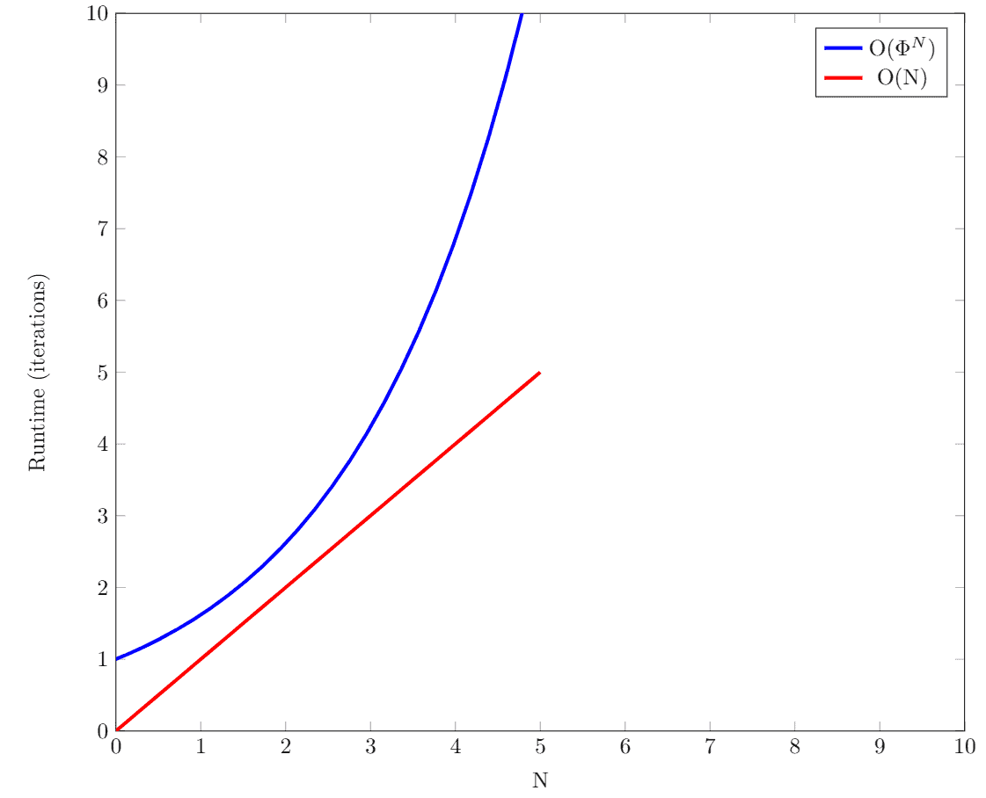
4.3.2 Comparison with recursion
The time complexity of the recursive solution is exponential – O(\Phi^N) to be exact. This is due to solving the same subproblems multiple times

Slide 74
Referfence: https://www.baeldung.com/cs/fibonacci-top-down-vs-bottom-up-dynamic-programming

Slide 75
Recurrence Relations
Have you ever wondered how to calculate the time complexity of algorithms like Fibonacci Series, Merge Sort, etc. where the problem is solved by dividing it into subproblems.
This is done by analyzing the Recurrence Relations of these algorithms.
A recurrence relation is a mathematical expression that defines a sequence in terms of its previous terms.
In the context of algorithmic analysis, it is often used to model the time complexity of recursive algorithms.

Slide 76
uses of Recurrence Relations
Time Complexity Analysis
Generalizing Divide and Conquer Algorithms
Analyzing Recursive Algorithms
Defining State and Transitions for Dynamic Programming.

Slide 77
There are mainly three ways of solving recurrences:
Recurrence Tree Method
Substitution Method
Master Method

Slide 78
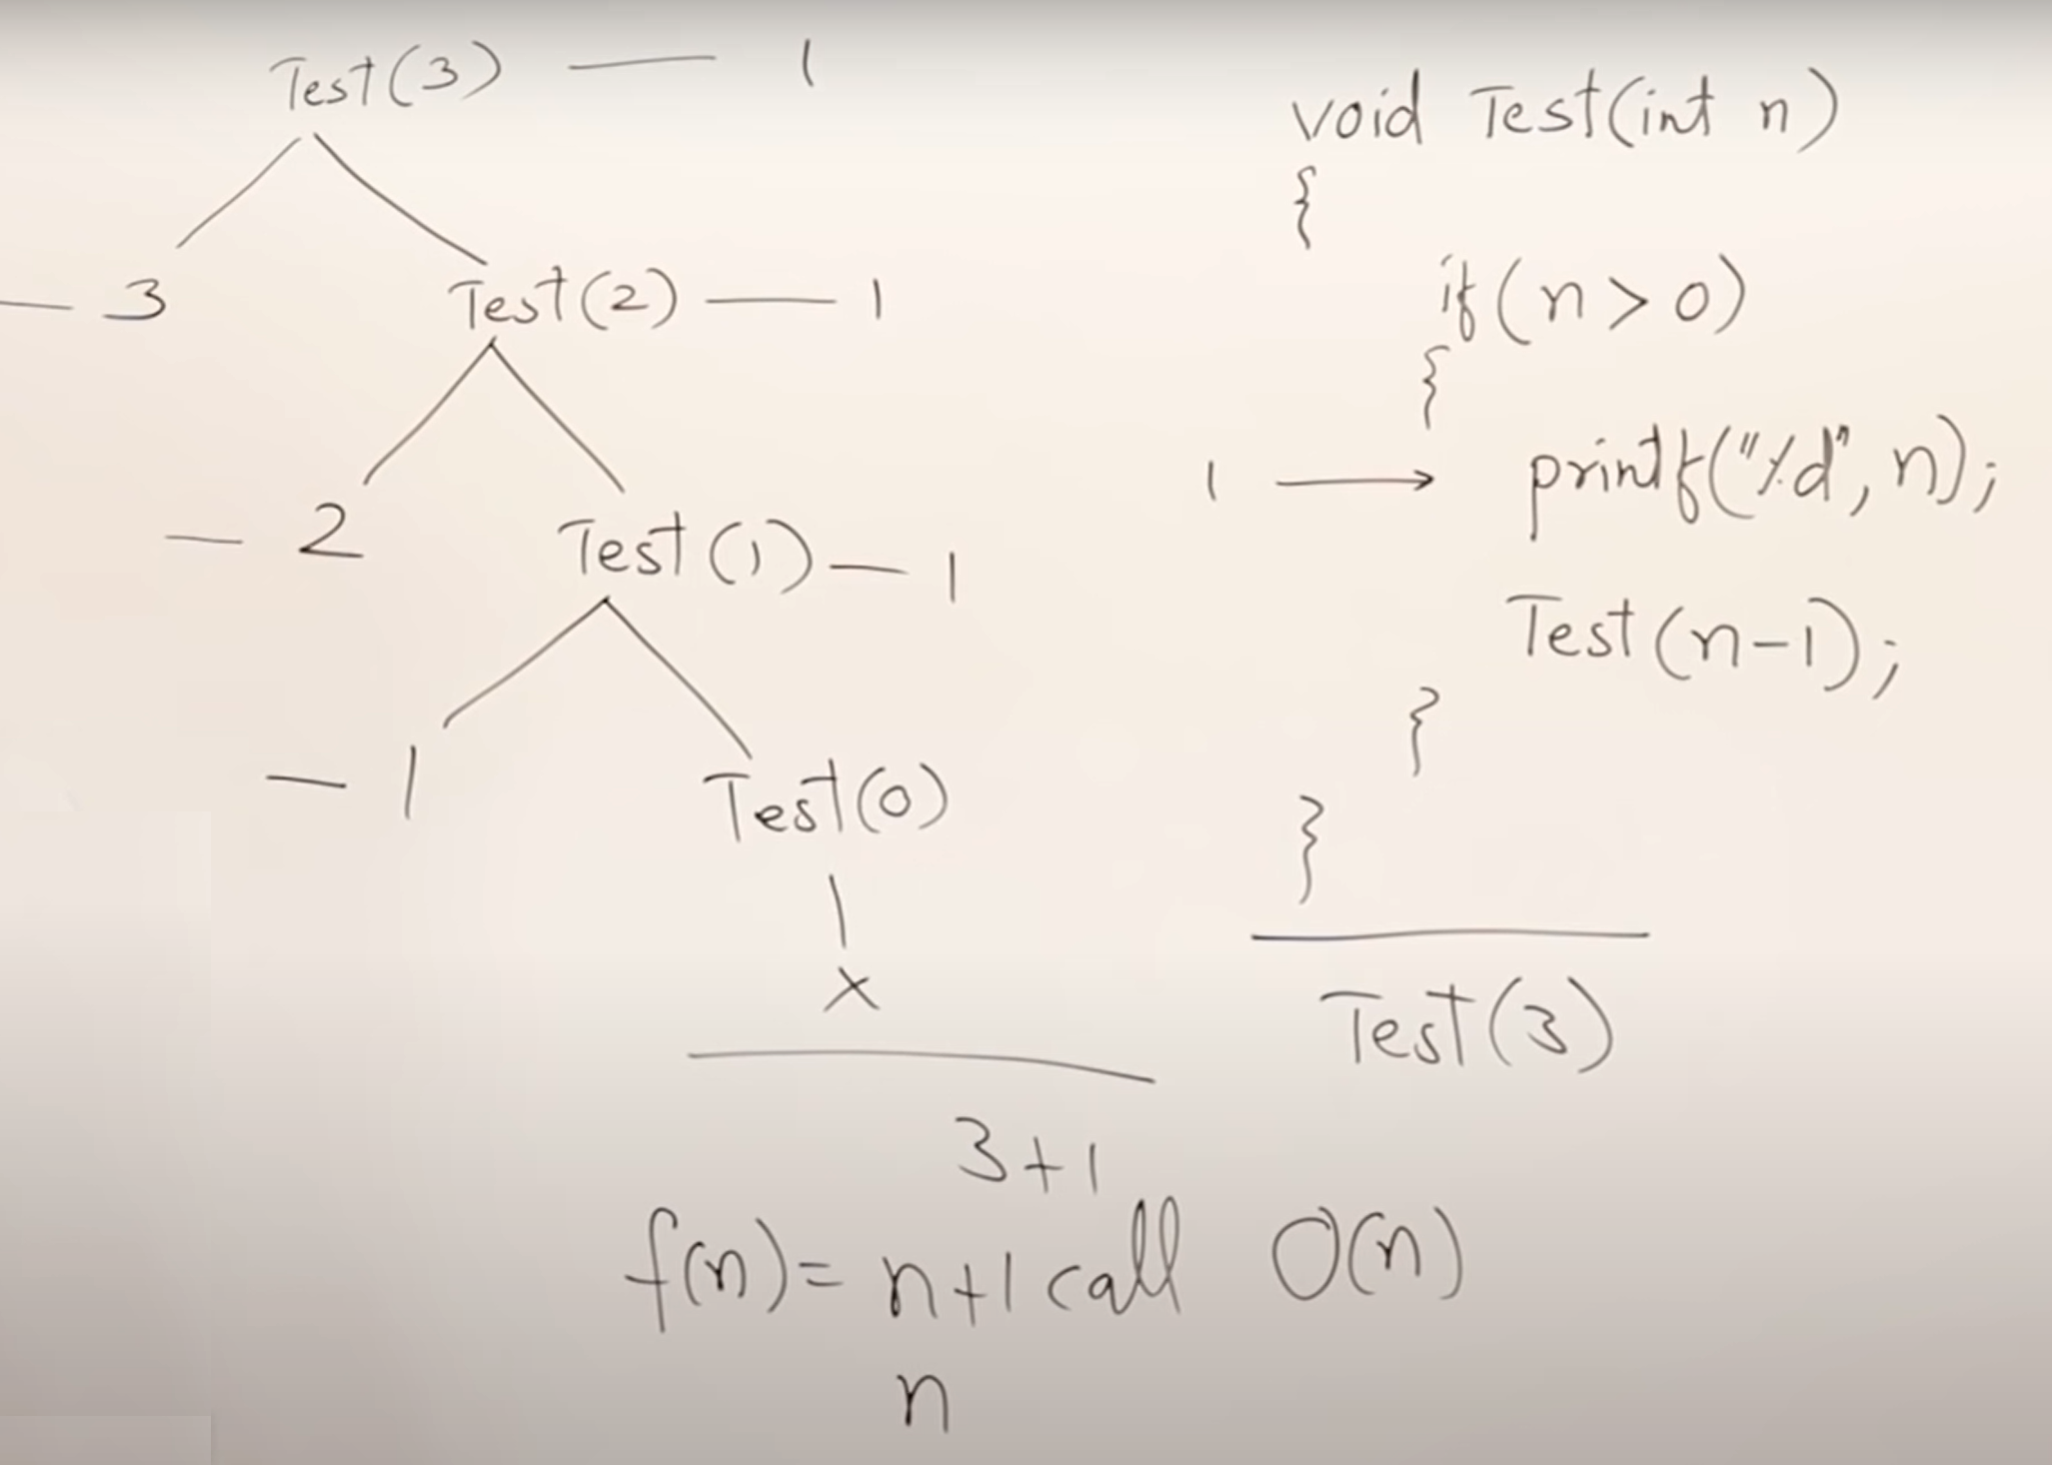
1. Recurrence tree method

Slide 79
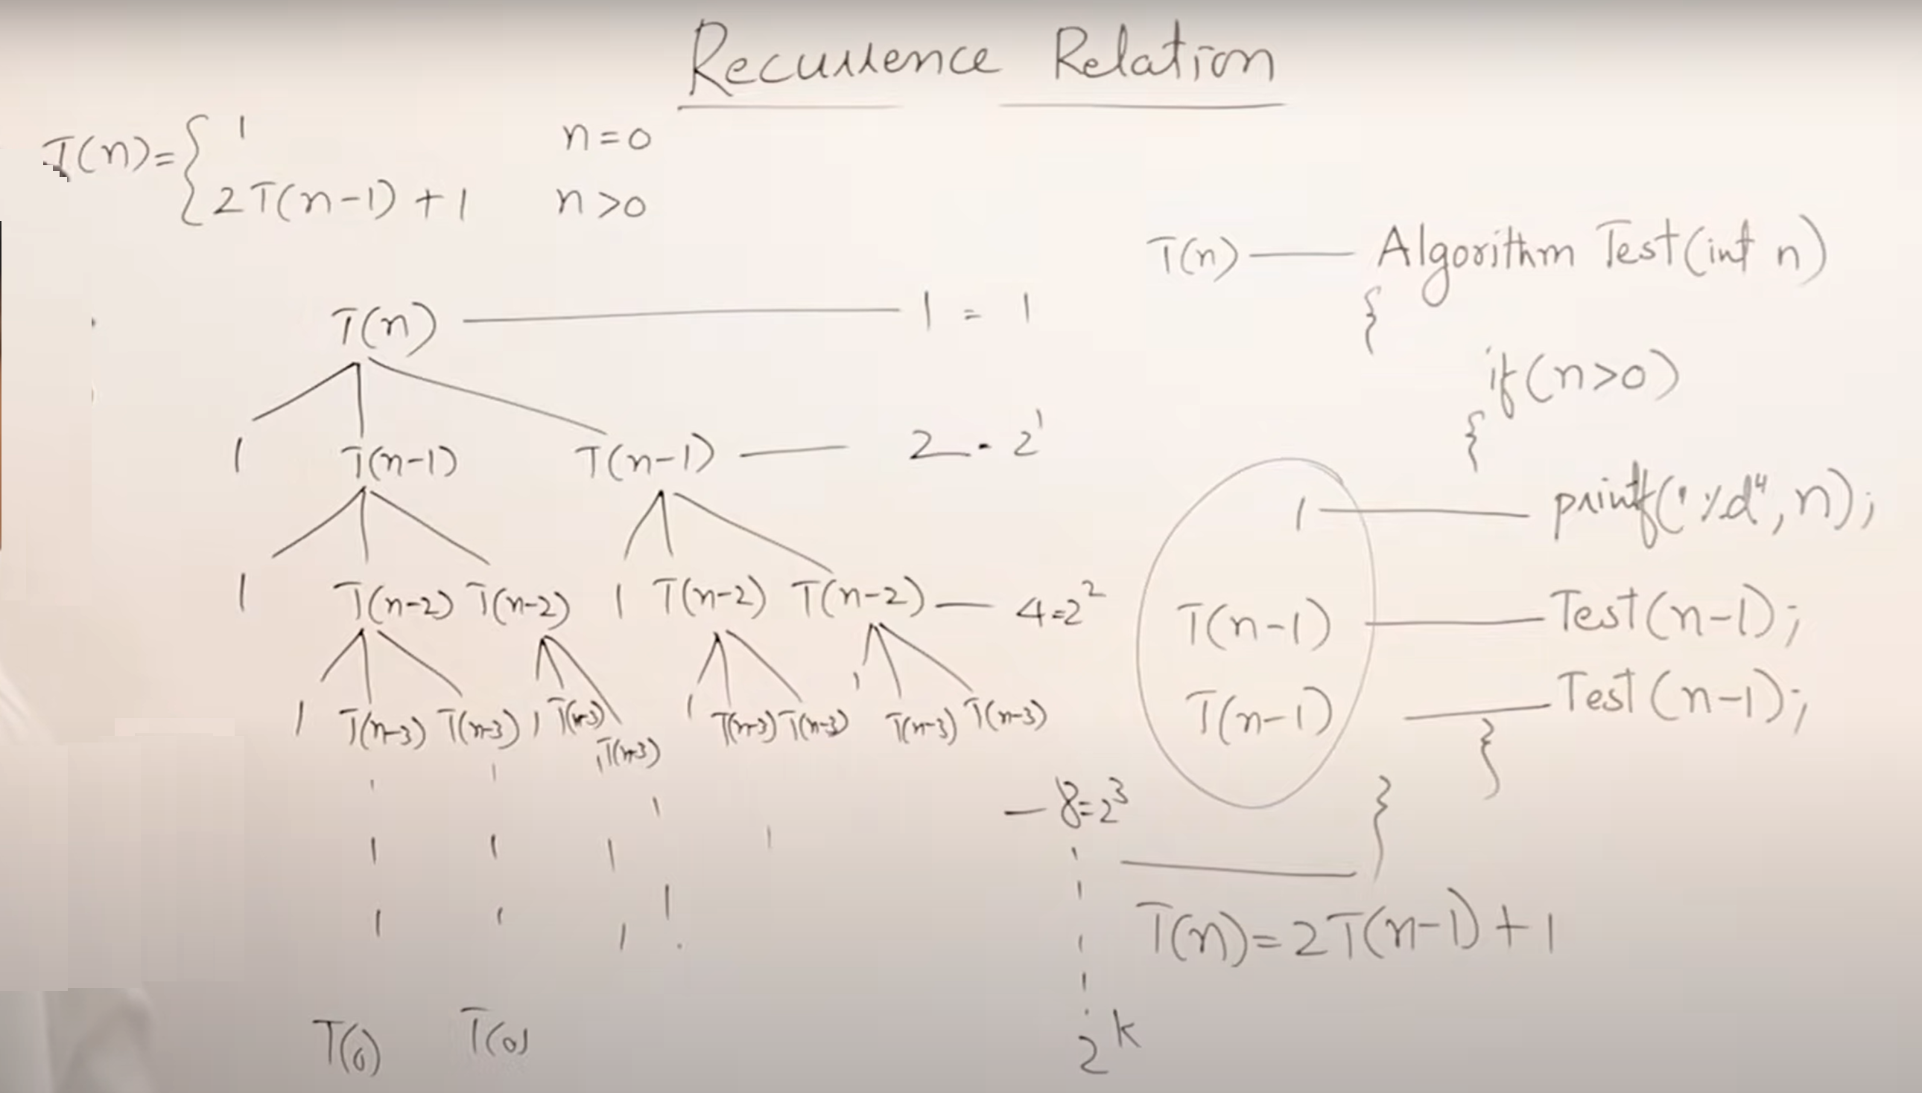

Slide 80
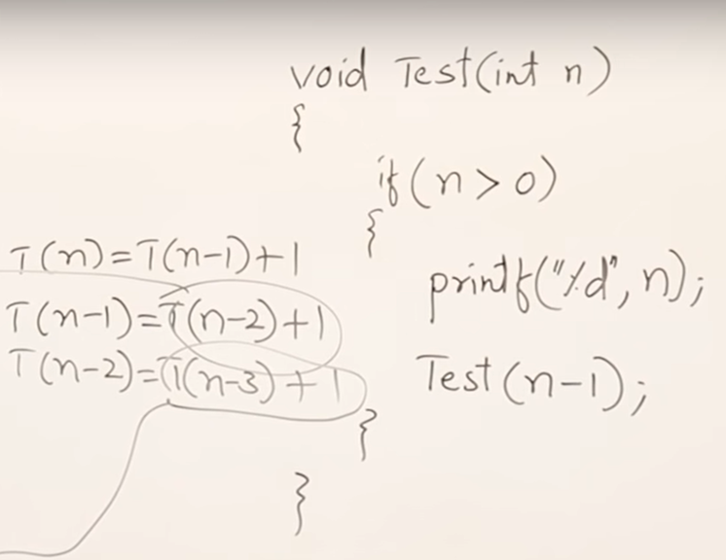
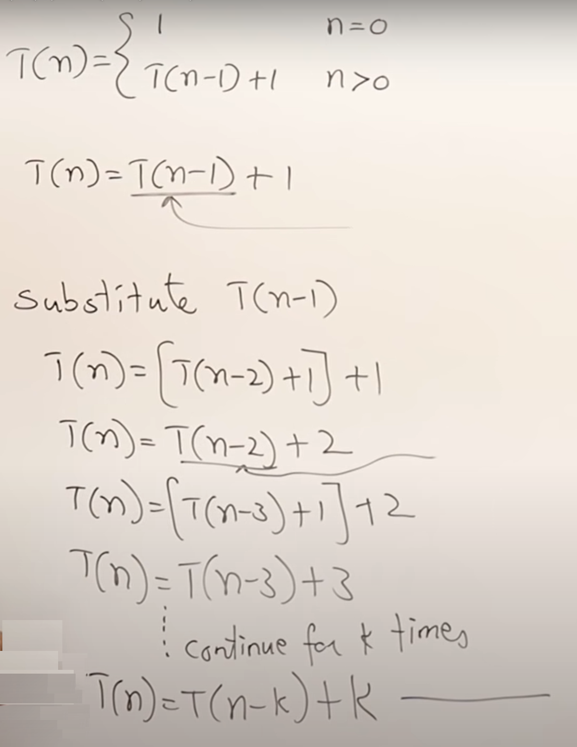
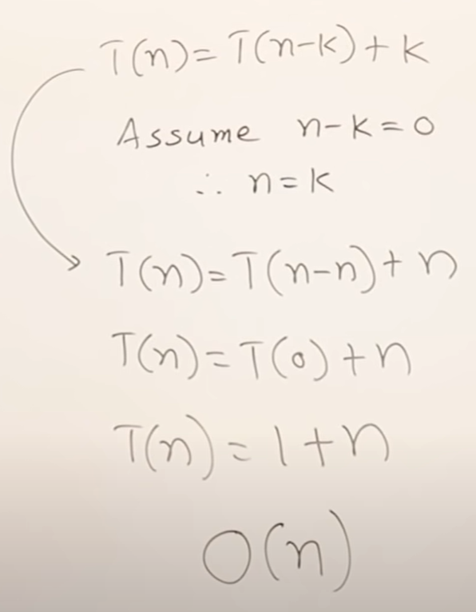
2. Substitution method

Slide 81
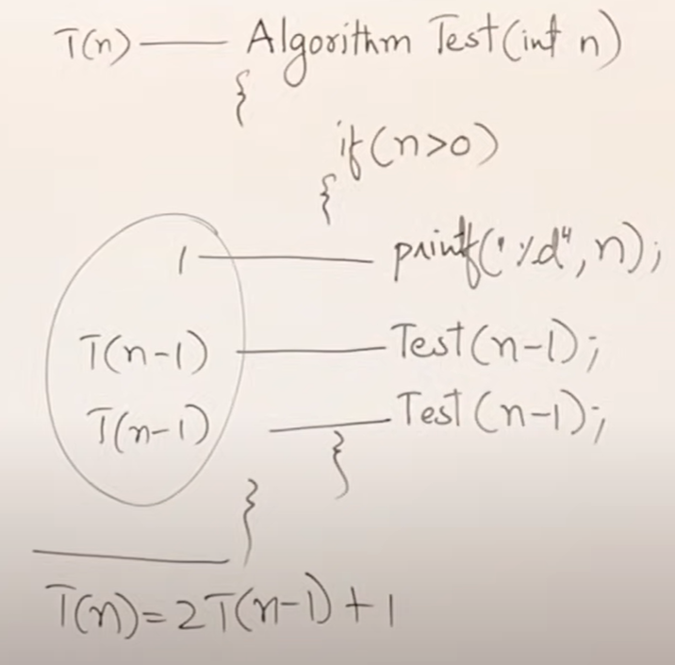
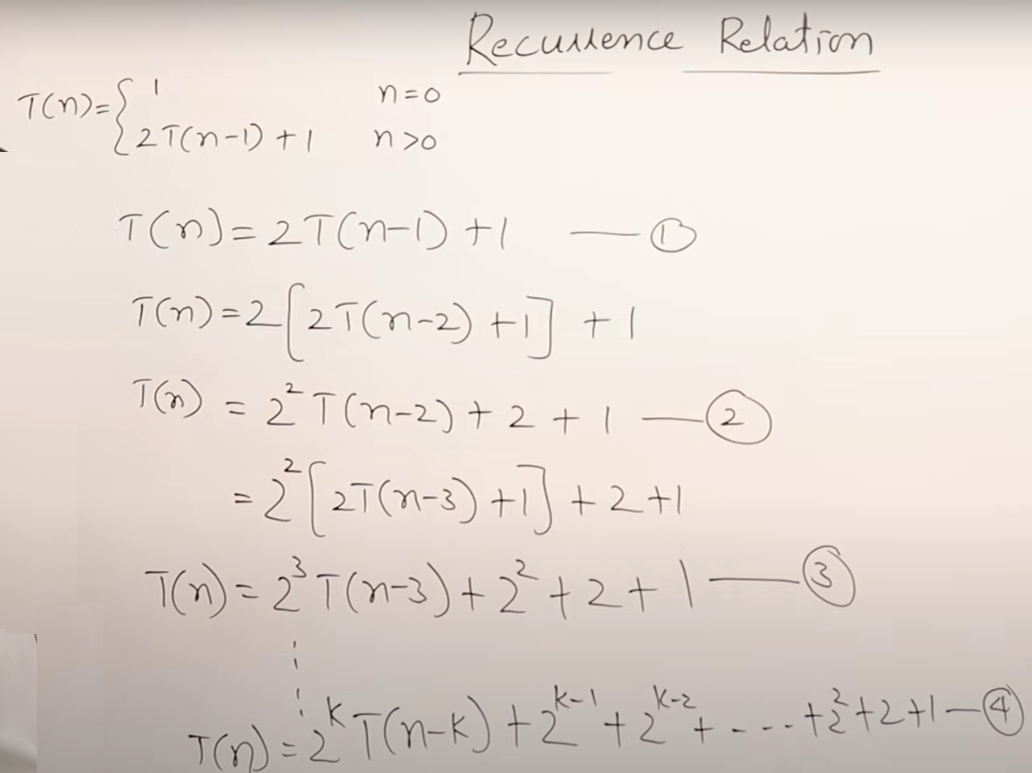
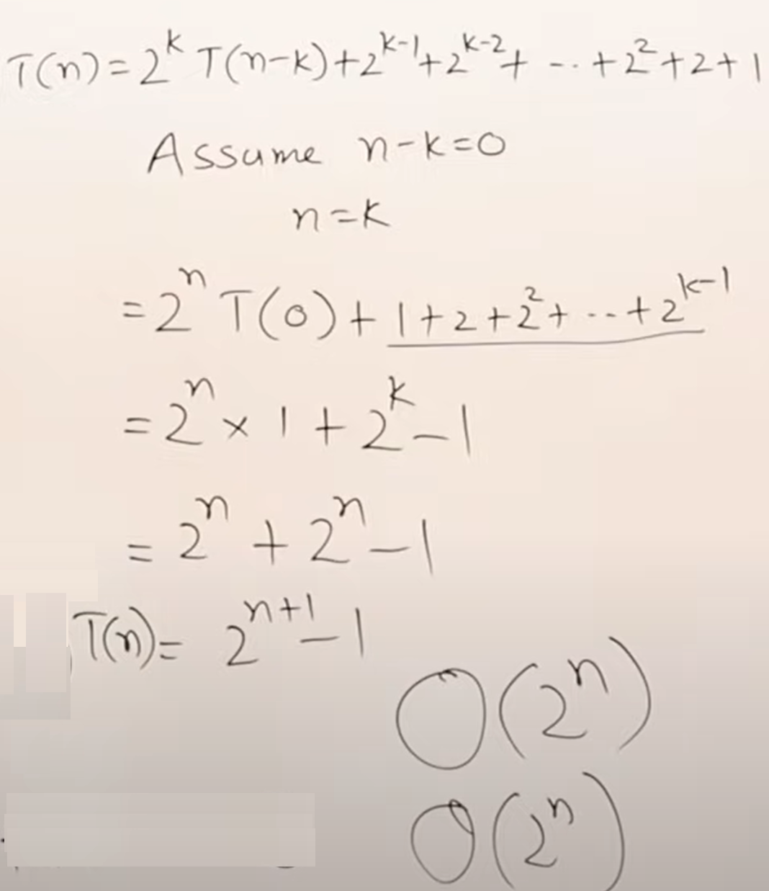

Slide 82
Linear Recurrence Relations:
T(n) = T(n-1) + n for n > 0 and T(0) = 1
These types of recurrence relations can be easily solved using substitution method.
For example,
T(n) = T(n-1) + n
= T(n-2) + (n-1) + n
= T(n-k) + (n-(k-1))….. (n-1) + n [Substituting k = n, we get]
T(n) = T(0) + 1 + 2+….. +n
= n(n+1)/2 = O(n^2)

Slide 83
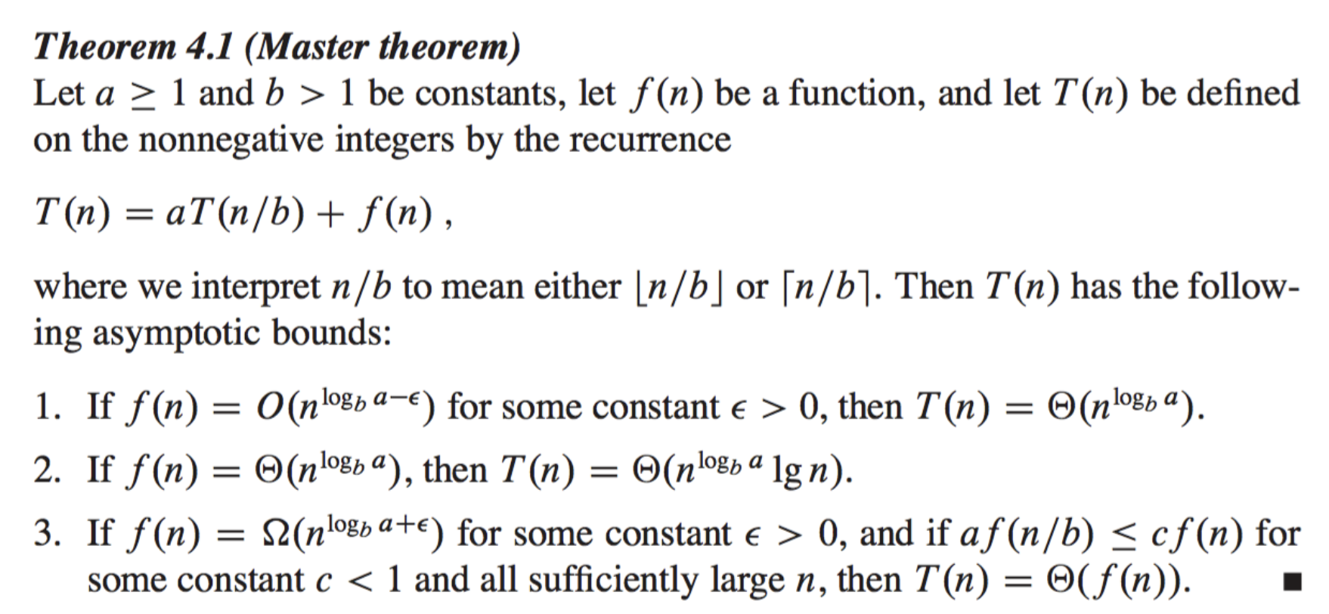
3. Master Method

Slide 84
The master theorem is a formula for solving recurrences of the for
T(n) = aT(n/b) +f(n),
where a ≥ 1 and b > 1
and f(n) is asymptotically positive.
(Asymptotically positive means that the function is positive for all sufficiently large n.)
This recurrence describes an algorithm that divides a problem of size n into a subproblems, each of size n/b, and solves them recursively

Slide 85
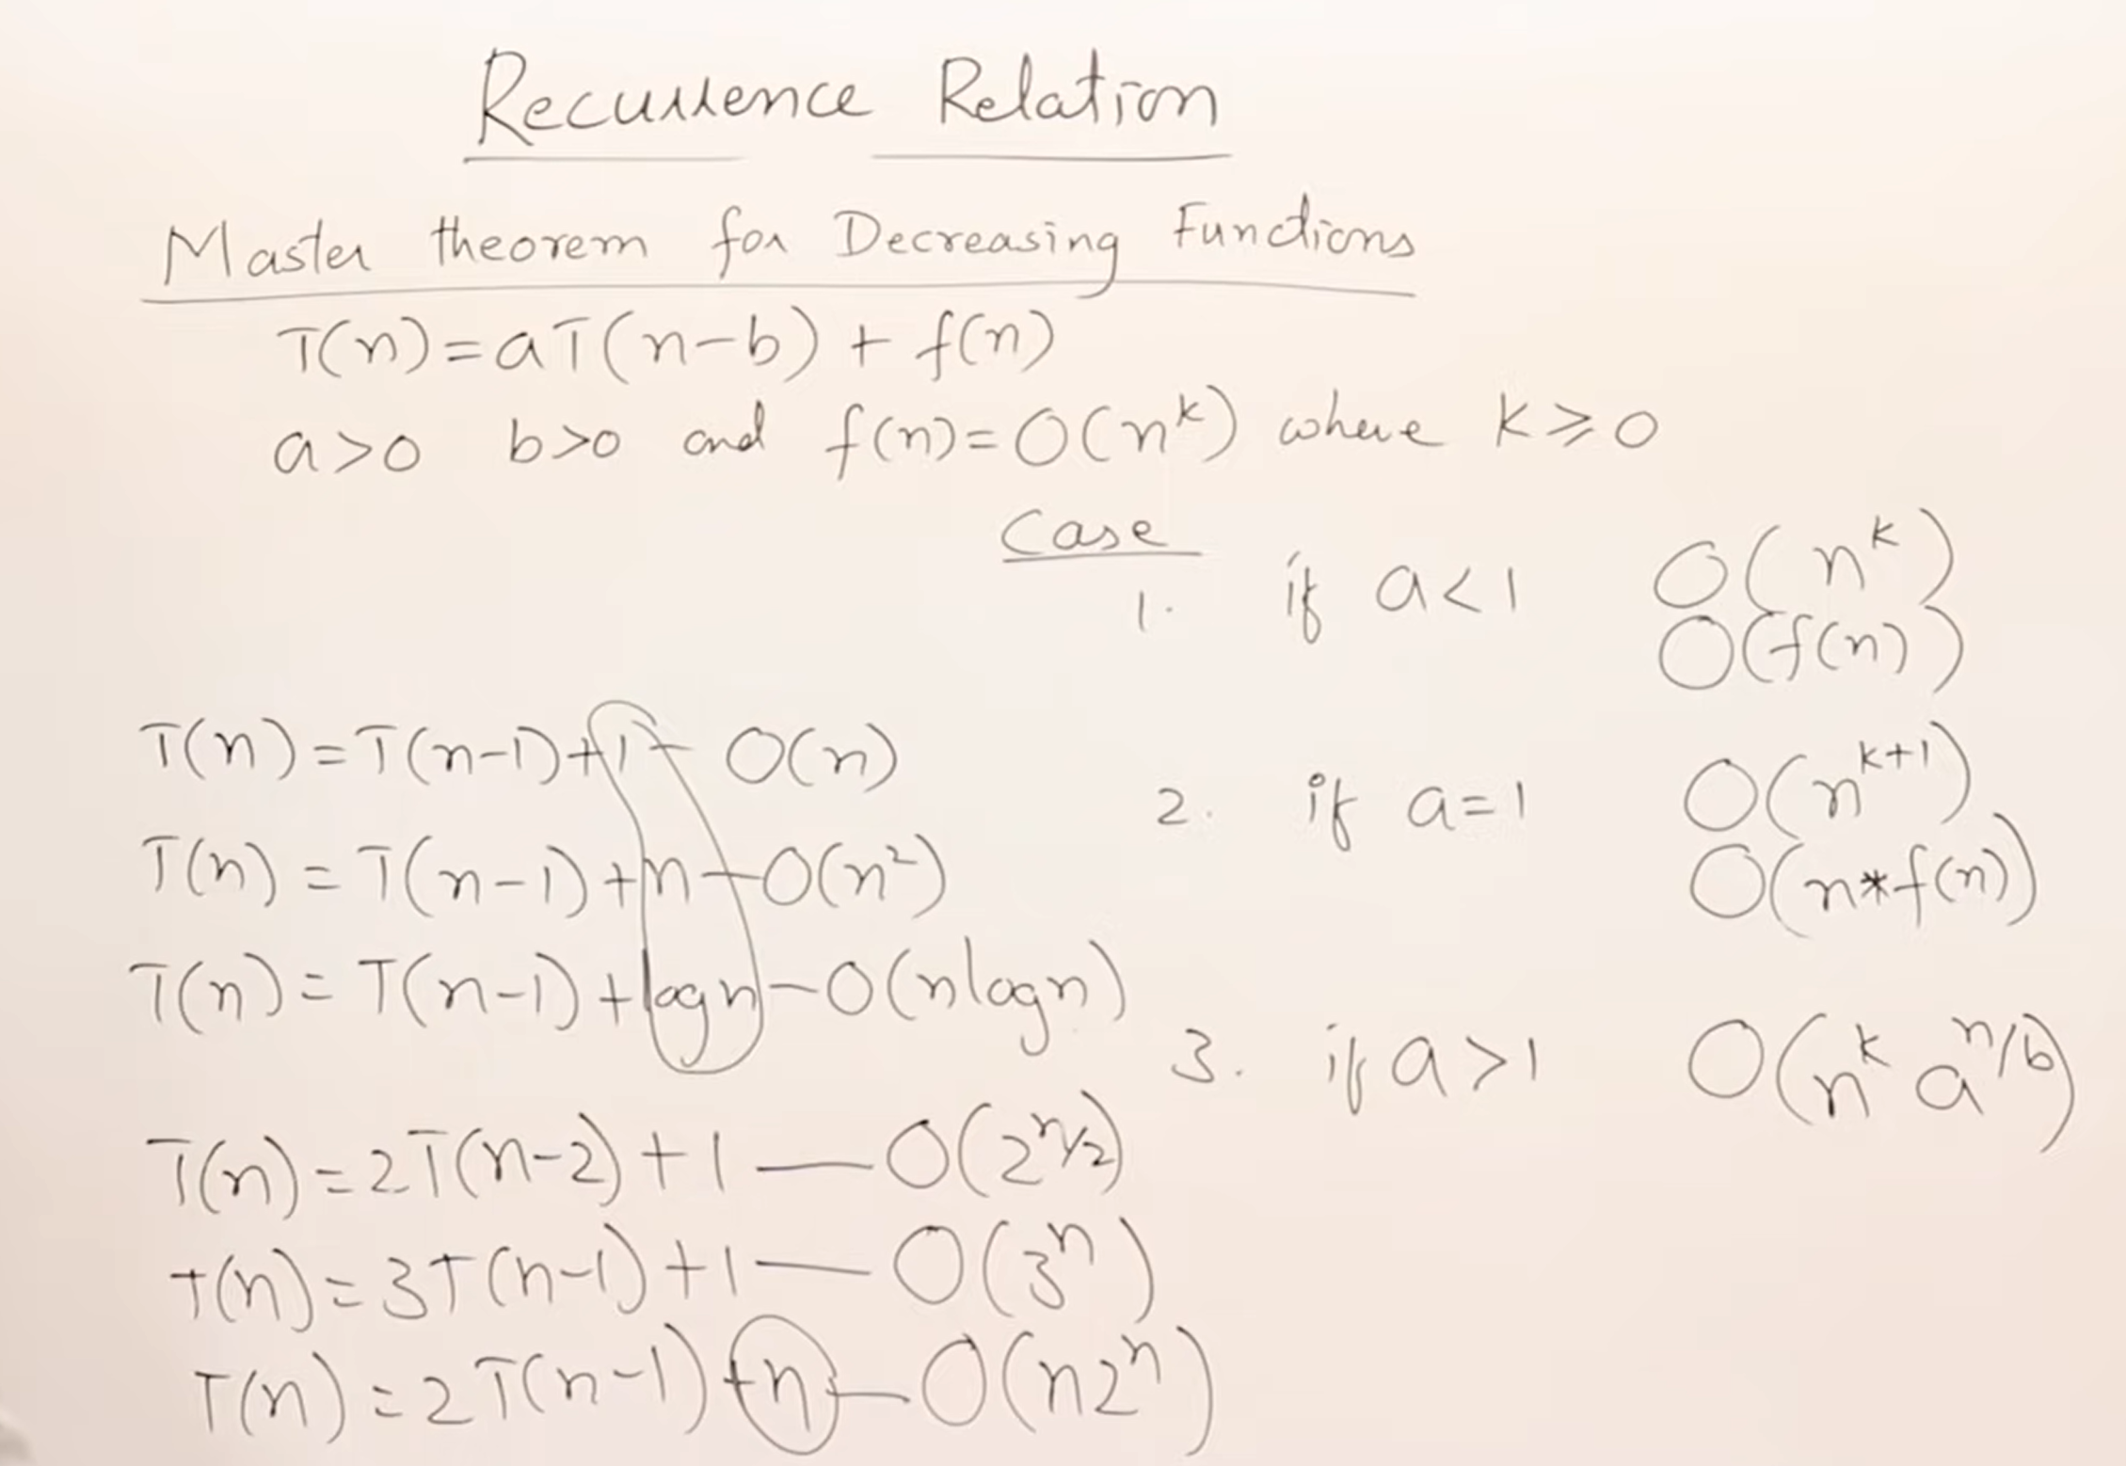

Slide 86
Example | Recurrence Relation
Fibonacci Sequence | F(n) = F(n-1) + F(n-2)
Factorial of a number n | F(n) = n * F(n-1)
Merge Sort | T(n) = 2*T(n/2) + O(n)
Tower of Hanoi | H(n) = 2*H(n-1) + 1
Binary Search | T(n) = T(n/2) + 1

Slide 87
4.4 Tabulation vs Memoization
Memoization (Top-Down Approach) is a technique where we start solving the problem recursively and store the results of subproblems to avoid recalculating them.
This approach is called top-down because we start with the original problem and break it down into smaller subproblems as needed.
Key Idea:
Solve the problem recursively.
Store the results of already solved subproblems in a cache (usually an array or hash map).
If a subproblem has already been solved, retrieve its result from the cache instead of recalculating it.

Slide 88
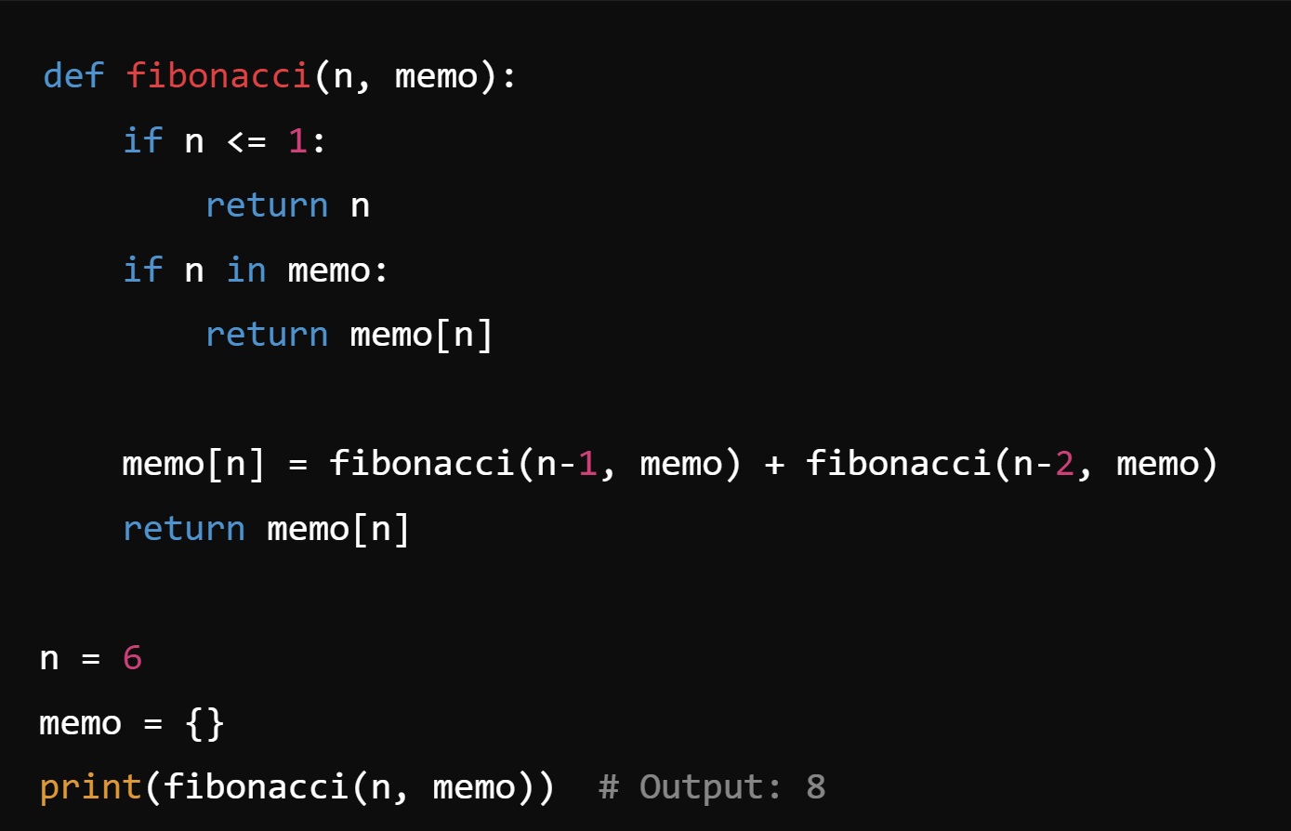
Example: Memoization
Fib(n) = Fib(n-1) + Fib(n-2)
Without memoization, the same subproblems would be solved multiple times.
Using memoization, we store the results of previously computed Fibonacci numbers to avoid recalculating them.

Slide 89
Characteristics of Memoization:
Top-Down: We start from the main problem (Fib(n)) and recursively solve smaller subproblems as needed.
Recursion: Memoization relies heavily on recursion.
Caching: Subproblems are cached as they are solved.
Efficient Space Usage: Only the subproblems needed are computed and cached, making it more space-efficient for certain types of problems.

Slide 90
Tabulation (Bottom-Up Approach)
Tabulation is the opposite of memoization. It involves solving the problem by starting from the smallest subproblems and building up to the larger problem.
This is called a bottom-up approach because we solve the smallest subproblems first and use those results to build the solution for larger subproblems.
Key Idea:
Create a table (array) where each entry corresponds to the solution of a subproblem.
Start solving from the smallest subproblem and fill up the table iteratively.
The final solution will be found at the end of the table

Slide 91
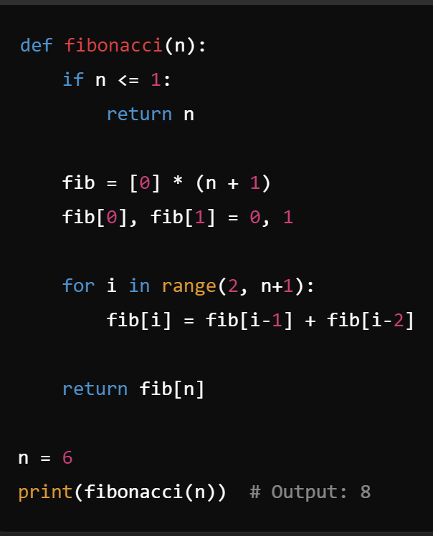
We create a table fib[] to store the Fibonacci numbers.
We iteratively fill up the table by calculating Fib(2), Fib(3), and so on, up to Fib(n).
Characteristics of Tabulation:
Bottom-Up: We start by solving the smallest subproblems (Fib(0), Fib(1)) and build up the solution.
Iteration: Tabulation uses loops rather than recursion.
Pre-filling Table: The table is filled systematically, and all subproblems are solved even if they are not required.
Space Usage: Sometimes tabulation can use more space since we compute and store all subproblems, even those not needed.

Slide 92
Tabulation | Memoization
In tabulation, the state transition is difficult to create. | State transition relation is easy to create.
Code becomes difficult when lots of conditions are needed. | Code is not complicated and it's not difficult to create.
It is fast as the result of the previously solved sub-problems can be directly accessed from the table. | It is slow because lots of recursive calls and return statements are required.
In a tabulated version, all the entries must be filled one by one. | In a memoized version, entries in the table are filled on demand.

Slide 93
Aspect | Memoization (Top-Down) | Tabulation (Bottom-Up)
Approach | Recursive, top-down approach. | Iterative, bottom-up approach.
Recursion | Uses recursion. | Does not use recursion, relies on iteration.
Storage of Results | Results are stored in a cache (often an array or hash map). Only the subproblems encountered are stored. | Uses a table (array) to store results of all subproblems.
Order of Solving | Larger problem is broken down into smaller ones. | Starts solving the smallest subproblems and builds up.
Efficiency | Caches only the necessary subproblems, may use less memory. | May require more memory, as it solves all subproblems.
Stack Overflow Risk | Recursion can cause stack overflow if not managed properly (e.g., deep recursion). | No risk of stack overflow since it uses iteration.
Ease of Implementation | Easier for problems that naturally fit a recursive pattern. | More efficient but requires explicit table management.
Time Complexity | Same time complexity as tabulation (both reduce redundant calculations). | Same time complexity as memoization.
Space Complexity | Space complexity depends on the recursion stack and cache size. | Space complexity depends on table size.

Slide 94
When to Use Memoization vs Tabulation
Memoization:
Use when a problem naturally fits into a recursive solution (e.g., problems like Fibonacci, tree traversal).
Useful when you want to solve the problem only for specific subproblems rather than for all subproblems.
More intuitive when the problem is naturally recursive, but it may risk stack overflow for very deep recursion.
Tabulation:
Use when you want to avoid recursion (e.g., when concerned about stack overflow).
Useful when all subproblems need to be solved anyway, and a systematic bottom-up solution can be more efficient.
Efficient for problems where iterating from small to large subproblems is straightforward (e.g., dynamic programming problems involving arrays).

Slide 95
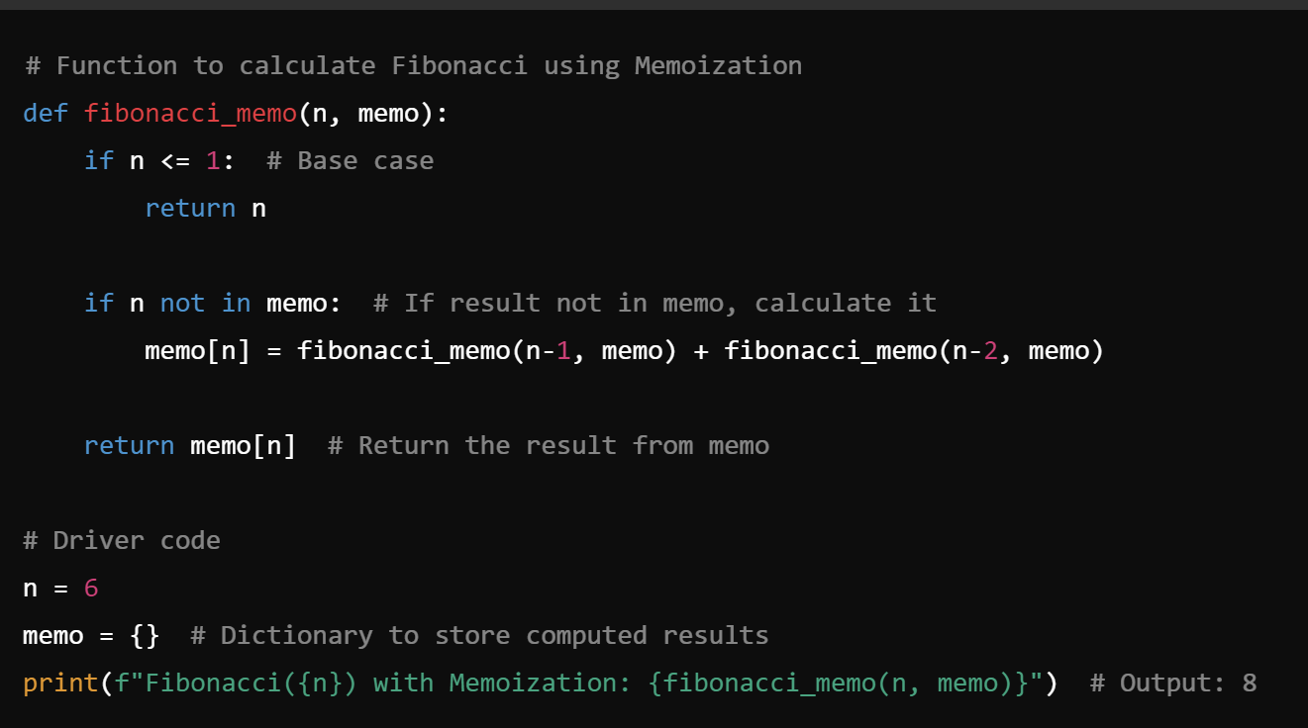
Memoization (Top-Down Approach)
Explanation:
The function recursively calculates Fibonacci numbers.
If a result for n is already computed, it's retrieved from memo, saving computation time.

Slide 96
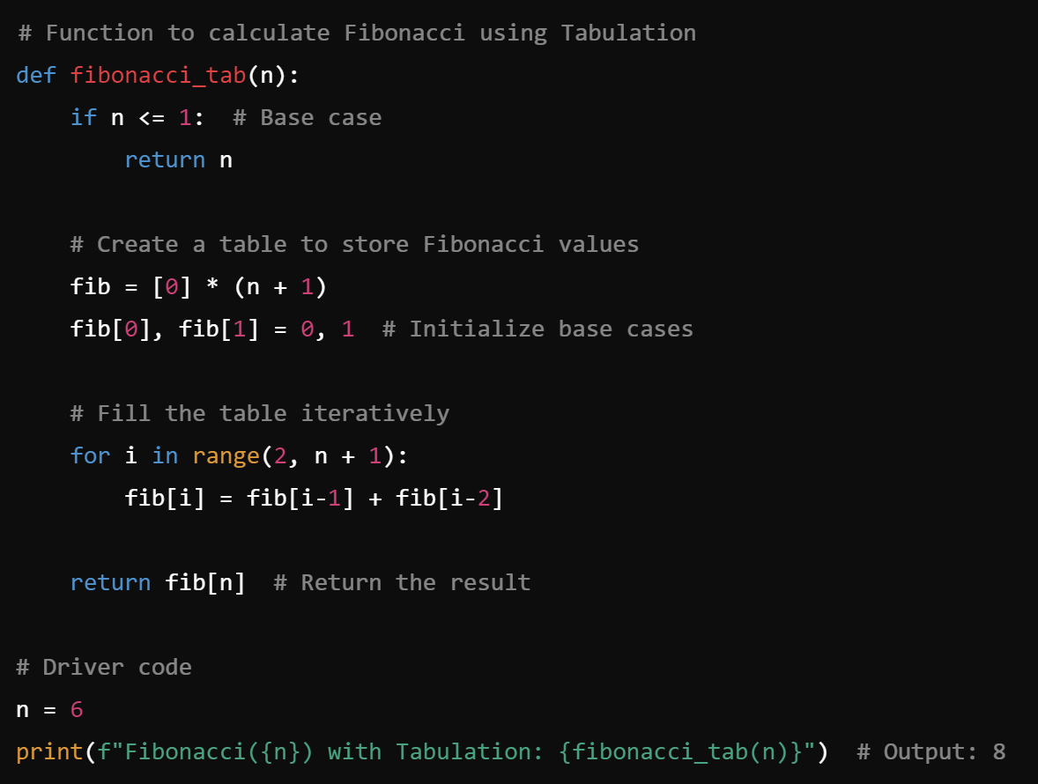
Tabulation (Bottom-Up Approach)
We use an iterative approach to calculate Fibonacci numbers. We start from the smallest subproblems and build up to the solution.
We create a list fib to store Fibonacci numbers.
Starting from the base cases (Fib(0) and Fib(1)), we iteratively calculate each Fibonacci number up to n.

Slide 97
4.5 Property in Dynamic Programming
The following are the two main properties of a problem that suggest that the given problem can be solved using Dynamic programming:
1) Overlapping Subproblems
2) Optimal Substructure

Slide 98
 | 1. Overlapping Subproblems | 2. Optimal Substructure
Concept | It occurs when a problem can be broken down into smaller subproblems, and these subproblems are reused multiple times. This property is fundamental to DP because we can store the results of these repeated subproblems to avoid redundant calculations. | A problem exhibits Optimal Substructure if the optimal solution to the problem can be constructed from the optimal solutions to its subproblems. This means that solving each subproblem optimally leads to the optimal solution for the overall problem.
Example | Fibonacci Sequence: Fib(n) = Fib(n-1) + Fib(n-2) | Shortest Path Problem” Shortest(A, C) = Shortest(A, B) + Shortest(B, C)
DP way: | Memoization & Tabulation | DP takes advantage of this property by solving subproblems independently and combining their solutions to form the overall optimal solution. Eg. Floyd-Warshall and Dijkstra’s Algorithm for shortest paths leverage the optimal substructure property.
Summary | It means that the problem has subproblems that are solved multiple times. DP stores their solutions to avoid redundant work. | It means that the overall optimal solution can be obtained by combining optimal solutions to its subproblems. DP uses this property to build up the final solution.

Slide 99
4.6 Dynamic Programming Process and Techniques
1. Identify the set of subproblems: You should clearly and unambiguously define the set of subproblems that will make up your DP algorithm.
These subproblems must exhibit some kind of optimal substructure property.
The smaller ones should help to solve the larger ones.
This is often the hardest part of a DP problem, since locating the optimal substructure can be tricky.
2. Identify the relationship between subproblems: This usually takes the form of a recurrence relation.
Given a subproblem, you need to be able to solve it by combining the solutions to some set of smaller subproblems, or solve it directly if it is a base case.
You should also make sure you are able to solve the original problem in terms of the subproblems (it may just be one of them)!
3. Analyze the required runtime: The runtime is usually the number of subproblems multiplied by the time required to process each subproblem.
In uncommon cases, it can be less if you can prove that some subproblems can be solved faster than others, or sometimes it may be more if you can’t look up subproblems in constant time.

Slide 100
4.6.1 Identify if DP is Applicable
The first step is to determine if the problem can be solved using DP. For DP to be applicable, the problem must have the following properties:
Overlapping Subproblems: The problem can be broken into smaller, repeated subproblems.
Optimal Substructure: The optimal solution to the problem can be constructed from optimal solutions to subproblems.

Slide 101
4.6.2 Define the Recurrence Relation
Once DP is identified as a suitable method, the next step is to define a recurrence relation that describes the solution in terms of smaller subproblems.

Slide 102
4.6.3 Choose Between Memoization or Tabulation
The next step is to choose between two DP techniques for implementing the solution:
Memoization (Top-Down Approach): Start with the original problem and solve smaller subproblems recursively, storing their solutions to avoid redundant calculations.
Tabulation (Bottom-Up Approach): Start by solving the smallest subproblems iteratively and build up the solution.

Slide 103
4.6.4 Solve Subproblems and Store Results
In memoization, solve subproblems recursively and store their results in a cache to avoid recomputation.
In tabulation, iteratively solve each subproblem and store the results in a table or array.
By solving and storing the results of subproblems, DP ensures that each subproblem is solved only once, optimizing the overall solution.

Slide 104
4.6.5 Construct the Solution from Subproblems
Once all the subproblems are solved and their results are stored, use these results to construct the final solution.
For example, in the Fibonacci sequence, once Fib(n-1) and Fib(n-2) are computed, the final solution for Fib(n) is calculated directly.

Slide 105
4.6.6 Analyze Time and Space Complexity
After implementing the DP solution, analyze its time and space complexity:
Time Complexity: DP solutions usually reduce time complexity by avoiding redundant subproblem calculations. Memoization and tabulation generally have a time complexity of O(n) for problems like Fibonacci.
Space Complexity: The space complexity depends on the size of the cache or table used to store subproblem results. Memoization typically uses more space for recursion stacks, while tabulation uses more space for storing all subproblem solutions.

Slide 106
4.7 Formulating Dynamic Programming Problems
Identifying whether DP is suitable based on overlapping subproblems and optimal substructure.
Defining the recurrence relation.
Choosing the appropriate state variables.
Defining the state transition to move between subproblems.
Establishing the base cases.
Implementing either memoization or tabulation.
Optionally, reconstructing the solution if necessary.

Slide 107
End of UNIT 4

Slide 108
Unit V [Dynamic Programming Problems]

Slide 109
5.1 DP review
Dynamic Programming was invented by Richard Bellman, 1950. It is a very general technique for solving optimization problems.
Using Dynamic Programming requires that the problem can be divided into overlapping similar sub-problems.
A recursive relation between the larger and smaller sub problems is used to fill out a table.
The algorithm remembers solutions of the sub-problems and so does not have to recalculate the solutions.

Slide 110
Compared to a brute force recursive algorithm that could run exponential, the dynamic programming algorithm runs typically in quadratic time.
(Recall the algorithms for the Fibonacci numbers.)
The recursive algorithm ran in exponential time while the iterative algorithm ran in linear time.
The space cost does increase, which is typically the size of the table. Frequently, the whole table does not have to store.

Slide 111
5.2 Binomial coefficient

Slide 114
Box Stacking
Integer Knapsack Problem (Duplicate Items Forbidden)
Edit Distance
Longest Increasing Subsequence(LIS)
Longest Common Subsequence (LCS)
Balanced Partition Problem

